Slide 1

What is IDE
IDE stands for Integrated Development Environment.
Software suite that consolidates basic tools
required for software development.
Central hub for coding,
finding problems, and testing.
Designed to improve developer efficiency.

Slide 2
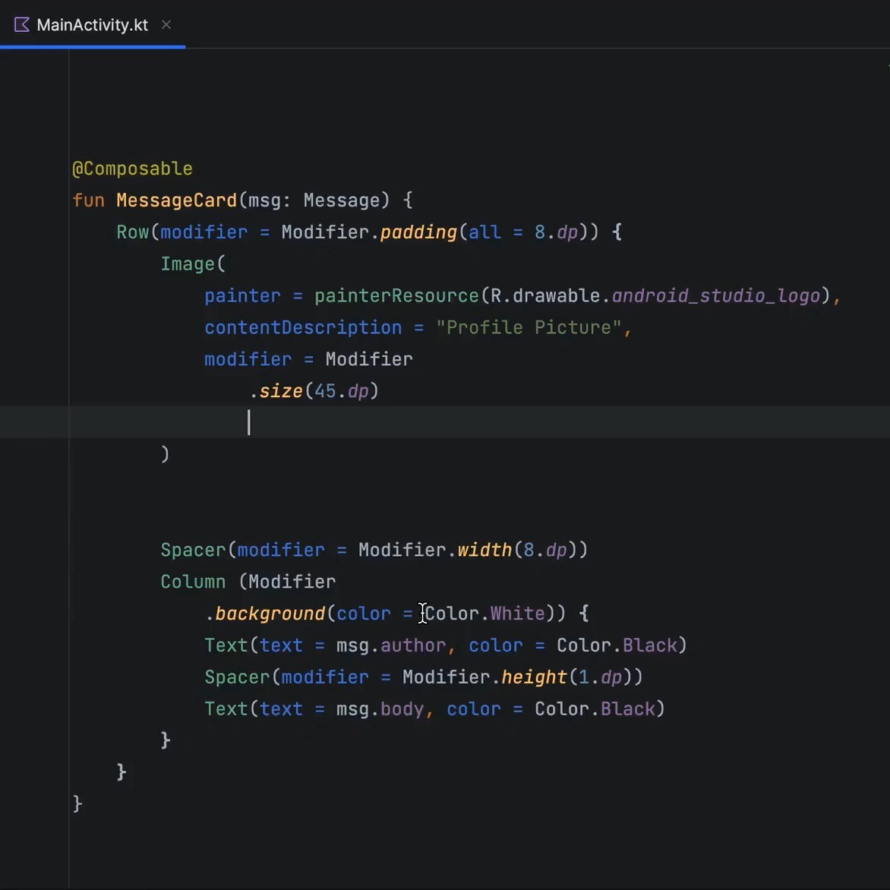
Need of IDE
Streamlines development.
Increases productivity.
Simplifies complex tasks.
Offers a unified workspace.
IDE Features
Code Autocomplete
Syntax Highlighting
Version Control
Error Checking

Slide 3

Installation & Setup
1. Search VS Code

Slide 4



VsCode Extensions
Live Server
Prettier

Slide 5







FrontEnd / BackEnd / FullStack
Client Side / Front- End
Web Development
Server Side Back-End
Full Stack

Slide 6
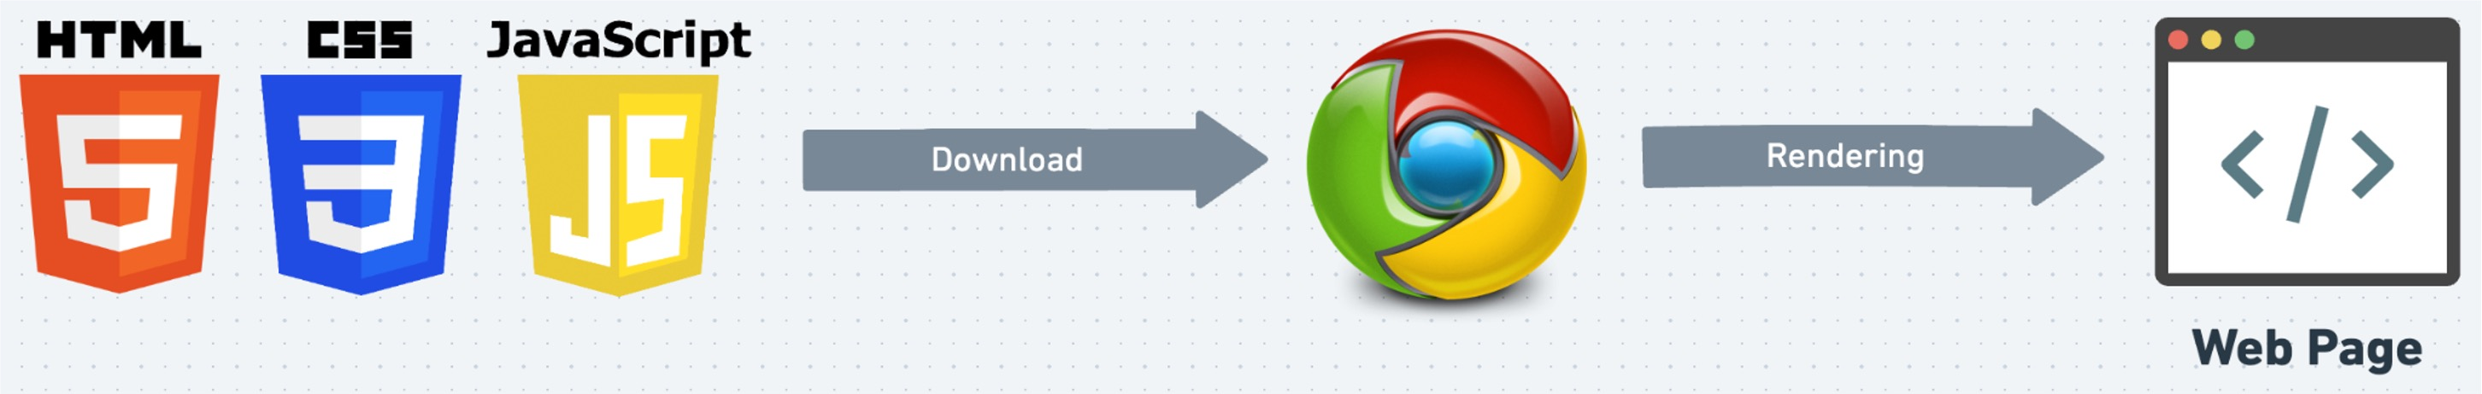
Role of Browser
Displays Web Page: Turns HTML code into what you see on screen.
User Clicks: Helps you interact with the web page.
Updates Content: Allows changes to the page using JavaScript.
Loads Files: Gets HTML, images, etc., from the server.

Slide 7

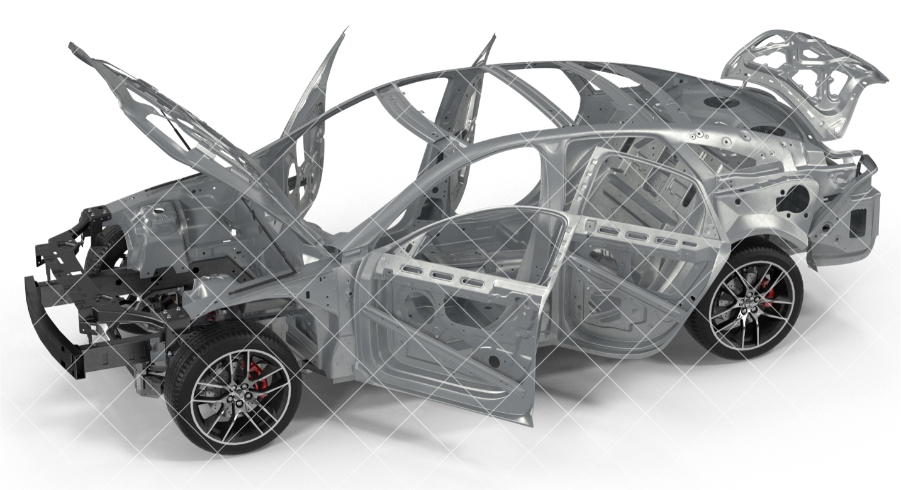
HTML
(Hypertext Markup Language)
Structure: Sets up the layout.
Content: Adds text, images, links.
Tags: Uses elements like
<p>, <a>.
Hierarchy: Organizes elements in a tree.

Slide 8

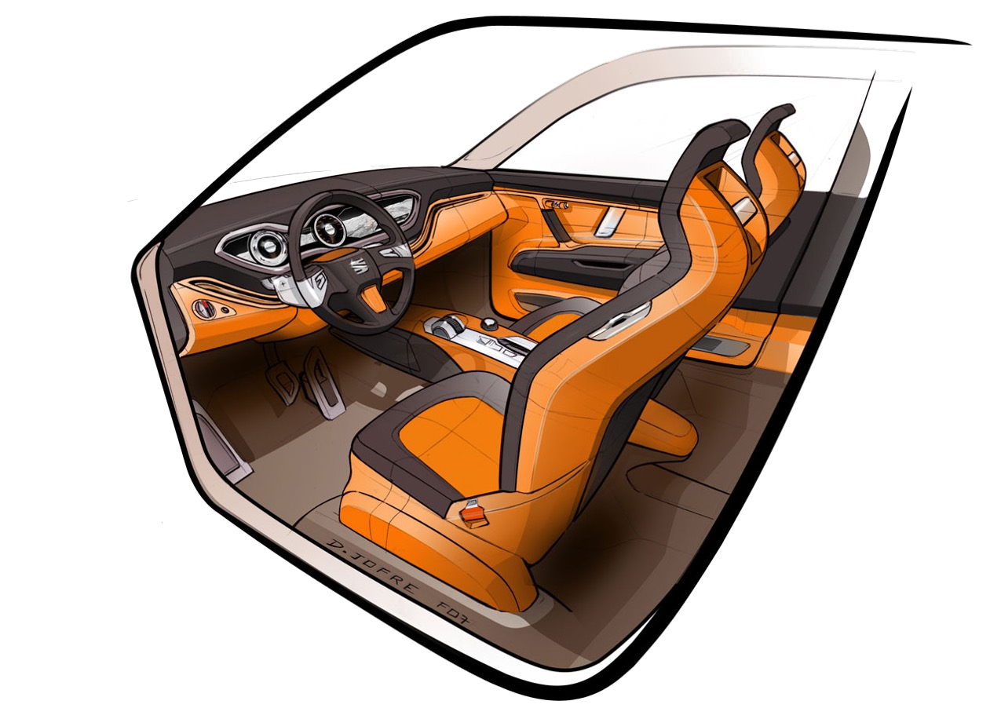
CSS
(Cascading Style Sheets)
Style: Sets the look and feel.
Colors & Fonts: Customizes text and background.
Layout: Controls position and size.
Selectors: Targets specific HTML elements.

Slide 9

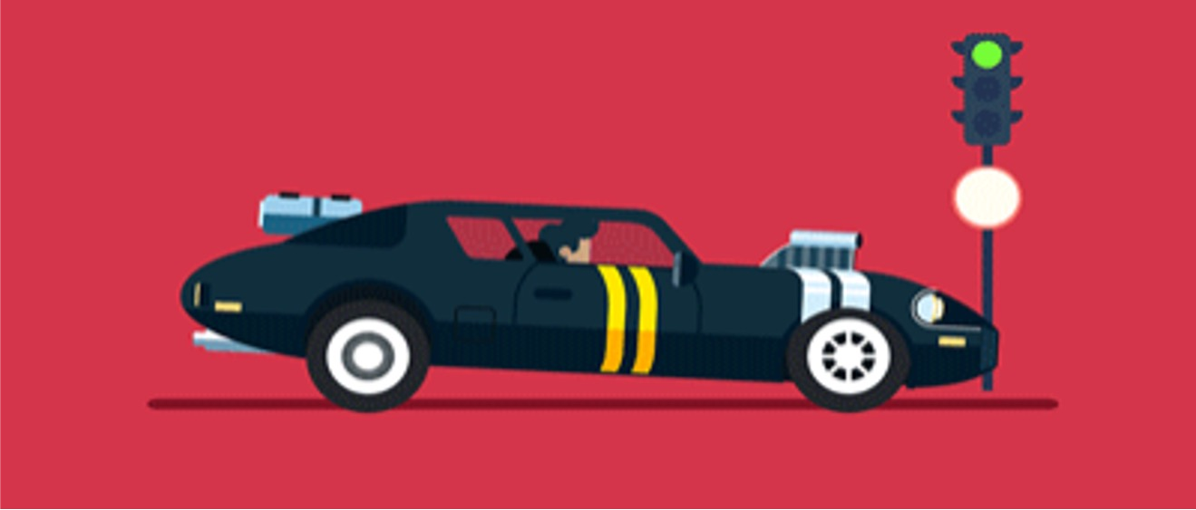
JS
(Java Script)
JavaScript has nothing to do with Java
Actions: Enables interactivity.
Updates: Alters page without reloading.
Events: Responds to user actions.
Data: Fetches and sends info to server.

Slide 10





Importance of CSS
Premium Website
Premium Brand
Premium Customer
High Salary Developer

Slide 11


Course Levels
Level 1 CSS Basics
Level 2 Color System and Background Level 3 Text Properties
Level 4 Box Model CSS Level 5 Display & Position
Level 6 Flexbox, Grid & Media Queries
Level 7 Animation, Transition & Transform Project: Myntra Clone

Slide 12
Level 1
CSS Basics
Basic Syntax
Color Property
Including Styles
HTML Refresher
Comments
MDN Documentation
Browser Tools
Selectors

Slide 13
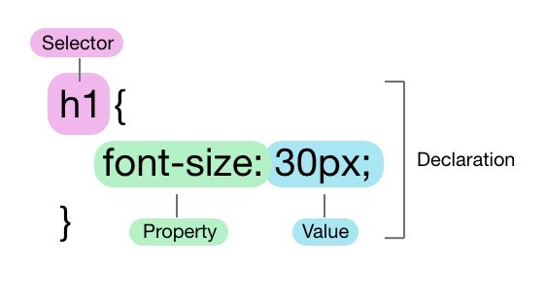
1. Basic Syntax
Selector: The HTML element that you want to style.
Property: The attribute you want to change (like font, color,
etc.).
Value: The specific style you want to apply to the property (like red, bold, etc.).

Slide 14
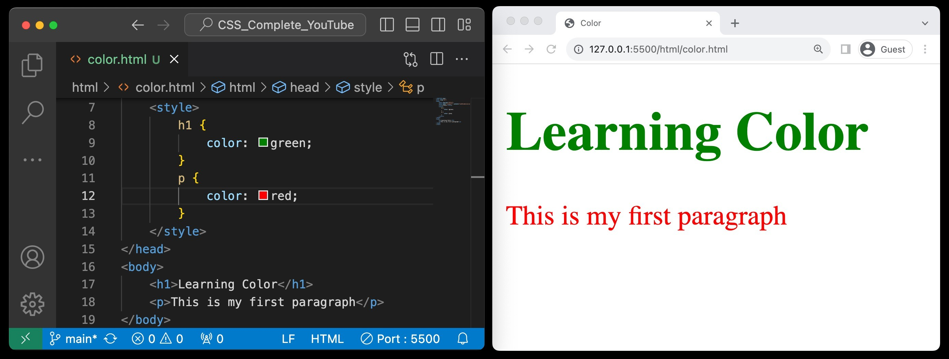
2. Color Property
Definition: The CSS color property defines the text color or foreground color in an HTML element.
Enhancement: Use it to emphasize sections and elevate webpage aesthetics.

Slide 15
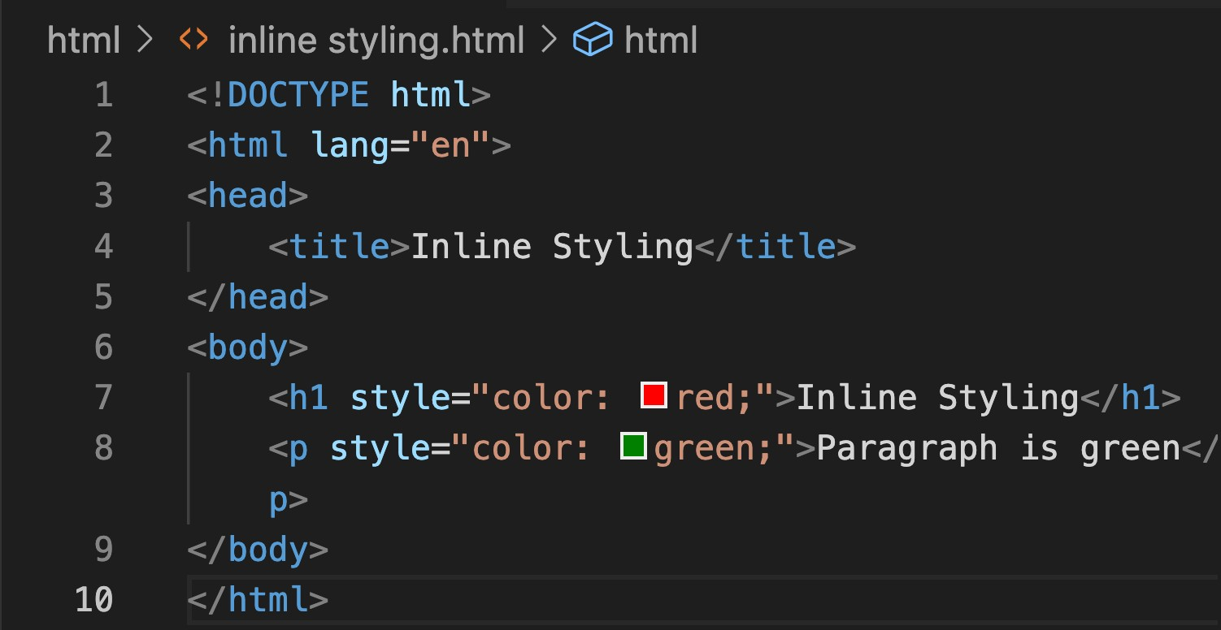
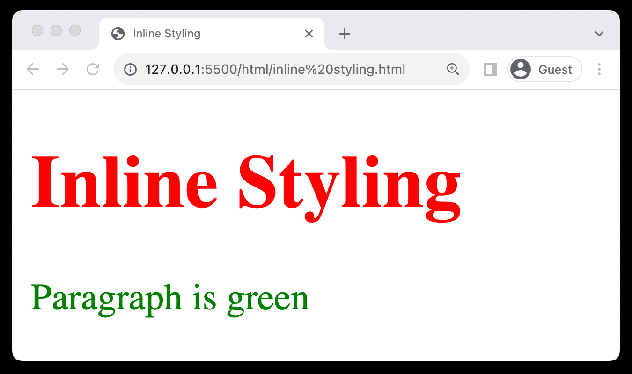
3. Including Styles (Inline Styling)
Direct Application: Apply styles directly to HTML elements using the style attribute.
One-off Changes: Ideal for single, unique style alterations.
Can Be Cluttered: May lead to cluttered HTML if used extensively.
Limited Reusability: Reduces the reusability of CSS rules in larger projects.

Slide 16
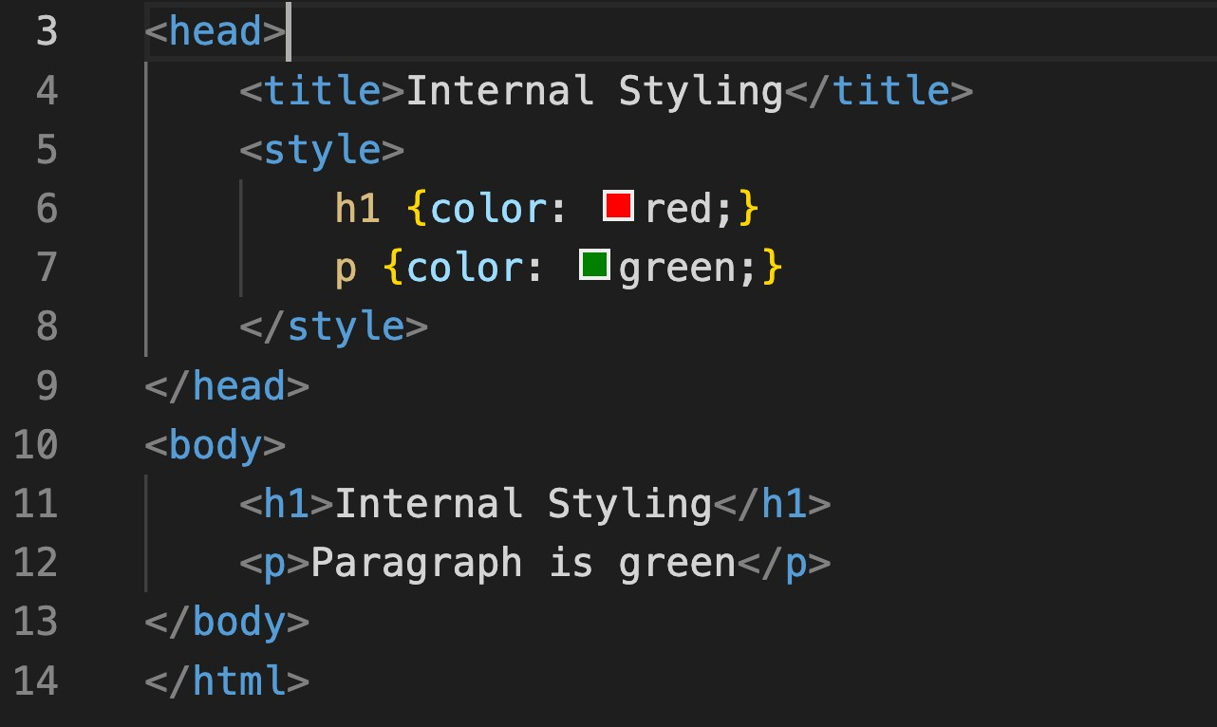
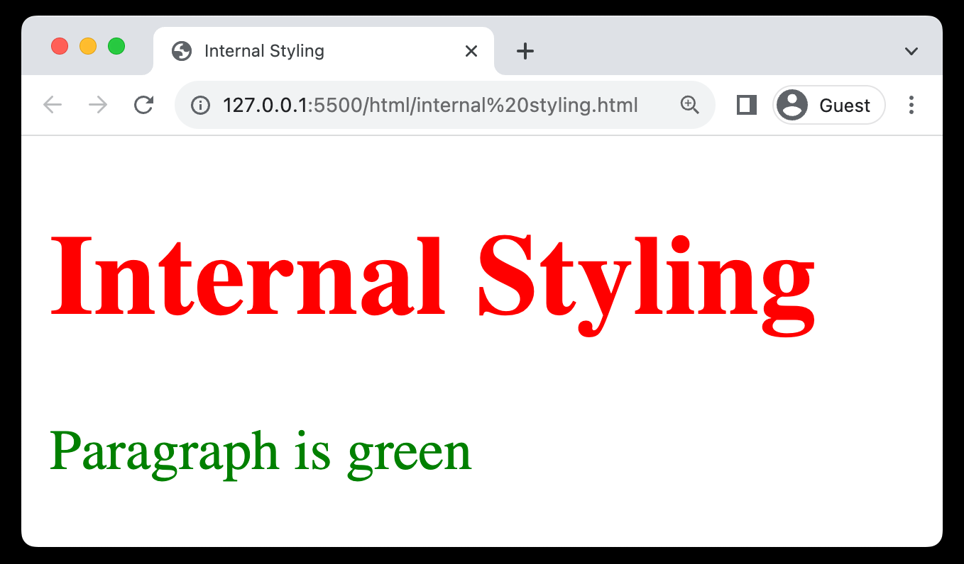
3. Including Styles (Internal Styling)
Embedded CSS: Styles are placed within <style> tags in the HTML head section.
Cleaner than Inline: More organized compared to inline styles.
Reusable Styles: Allows for some reuse of styles across the page.

Slide 17
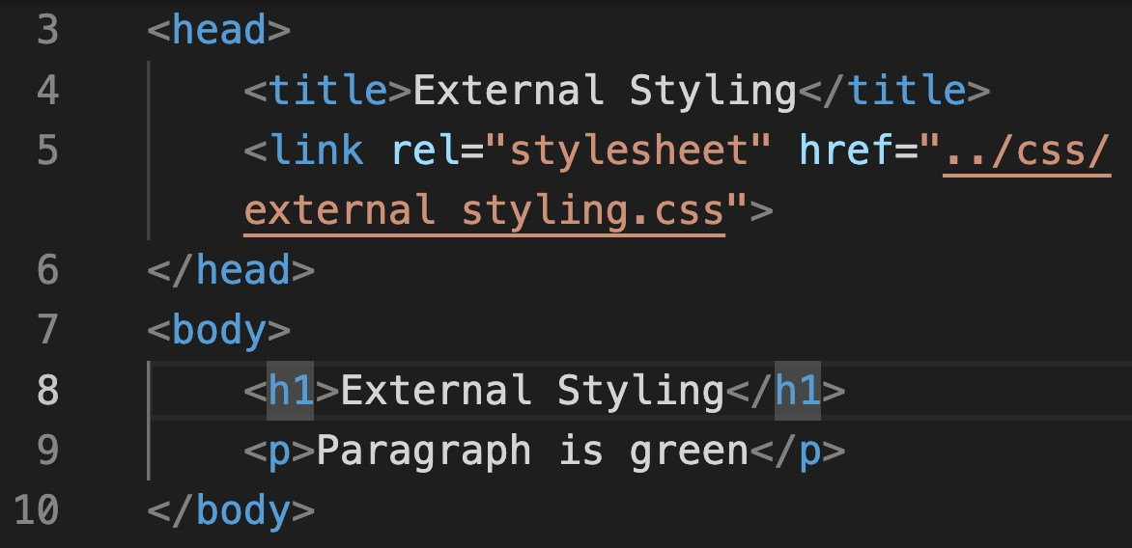
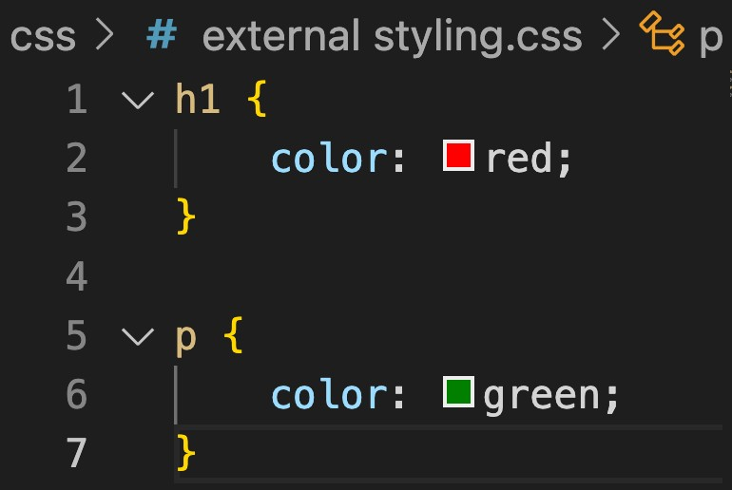
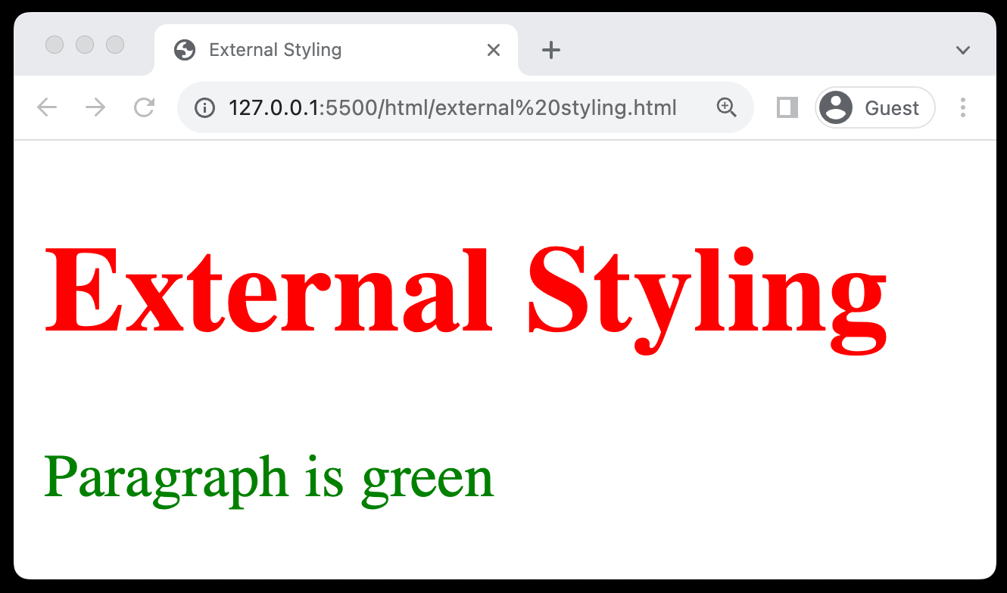
3. Including Styles (External Styling)
Separate CSS File: Stores styles in a separate .css file, linked to HTML.
Reusable: Enables style reuse across multiple webpages.
Link in HTML: Use the <link> tag within the <head> section to link the CSS.
Relative or Absolute Path: The href attribute can contain a relative or absolute path to the CSS file.

Slide 18
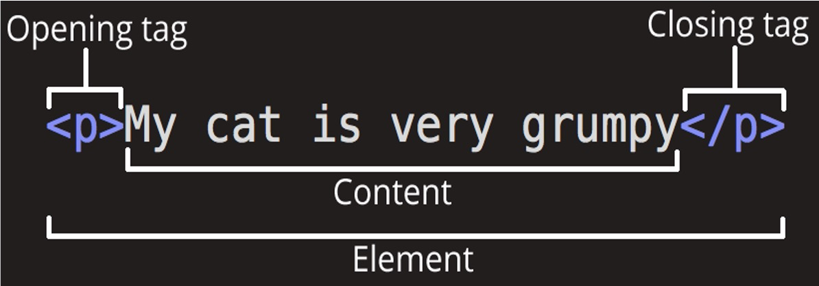
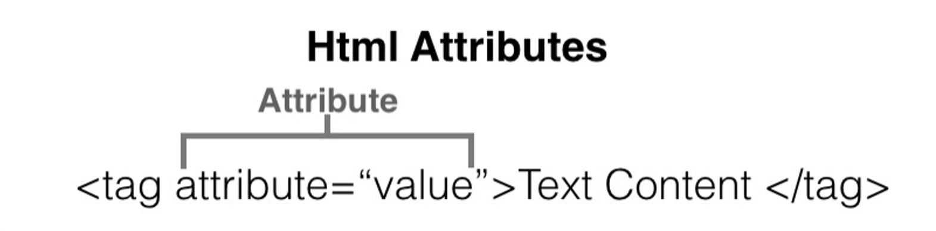
4. HTML Refresher (Tags & Attributes)
Elements that are used to create a website are called HTML Tags.
Tags can contain content or other HTML tags.
Define elements like text,
images, links
Provides additional information about elements
Use name=value format

Slide 19
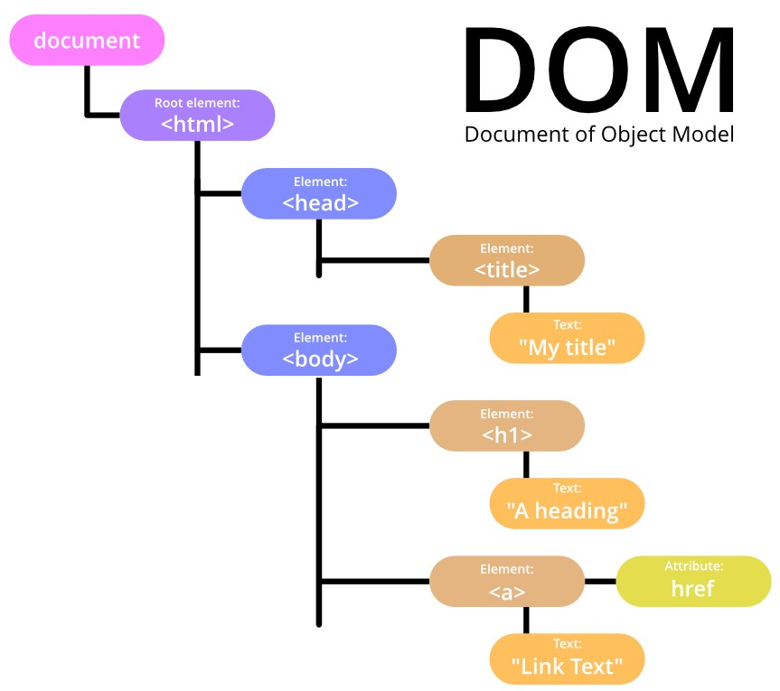
4. HTML Refresher (DOM)
Structure Understanding: Helps in understanding the hierarchical structure of a webpage, crucial for applying targeted CSS styles.
Dynamic Styling: Enables learning about dynamic styling, allowing for real-time changes and interactivity through CSS.

Slide 20
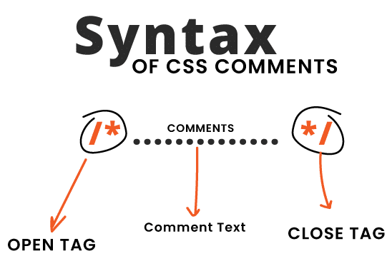
5 Comments
Used to add notes in HTML or CSS code
Not displayed on the web page
Syntax: <!-- Comment here -->
Helpful for code organization
Can be multi-line or single-line

Slide 21
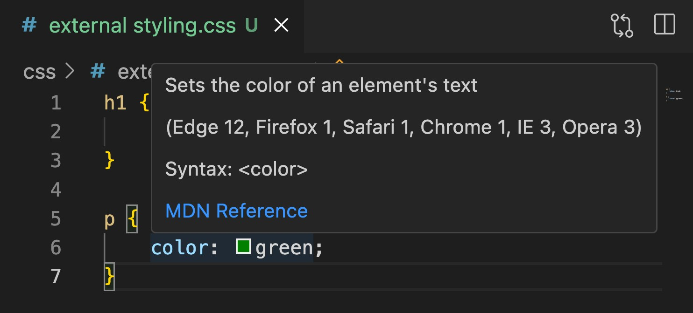
6.MDN Documentation
For Official resource for CSS, visit https://developer.mozilla.org/
Includes examples for real-world use
Updated with latest CSS-3 features
Trusted by developers worldwide

Slide 22
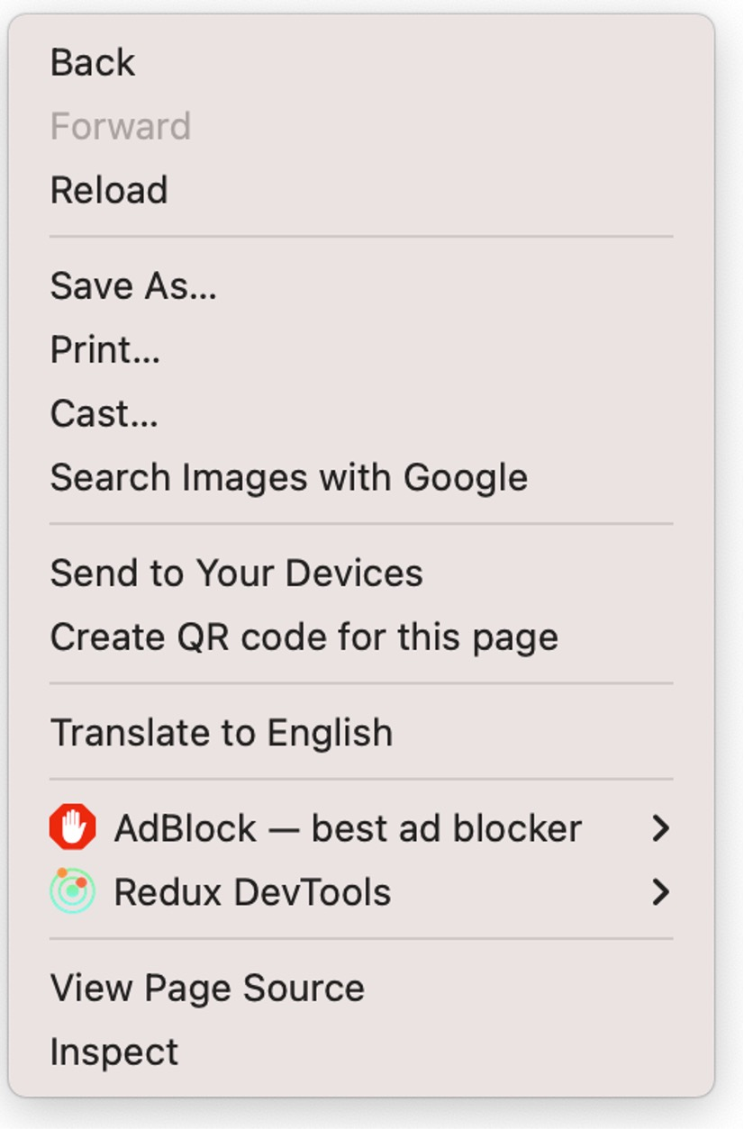
7.Browser Tools (Inspect element)
Allows real-time editing of HTML/CSS
Useful for debugging and testing
Shows element hierarchy and layout
Highlights selected elements on page

Slide 23

7.Browser Tools (Changes happening at Client)
Changes made are temporary
Affect only the current session
Not saved to the server
Reset upon page reload
Useful for testing, not permanent fixes
Like: If you change the question in your question paper that has no effect on actual exam.

Slide 24
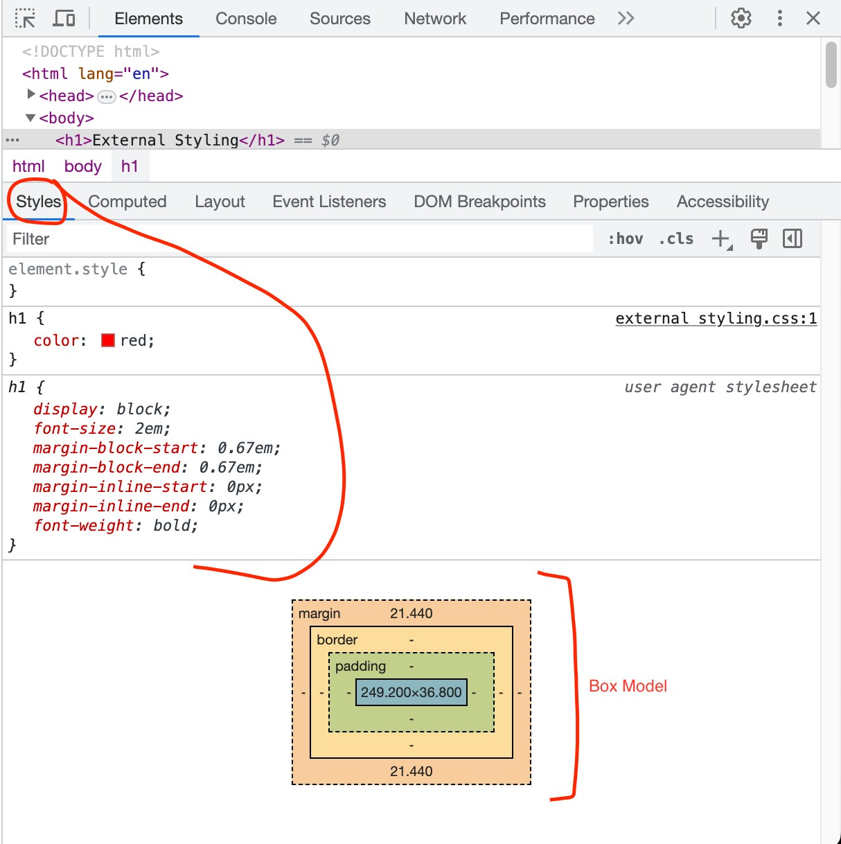
7.Browser Tools (CSS Specific element)
Styles Panel
Box Model
Changes happening only at client

Slide 25
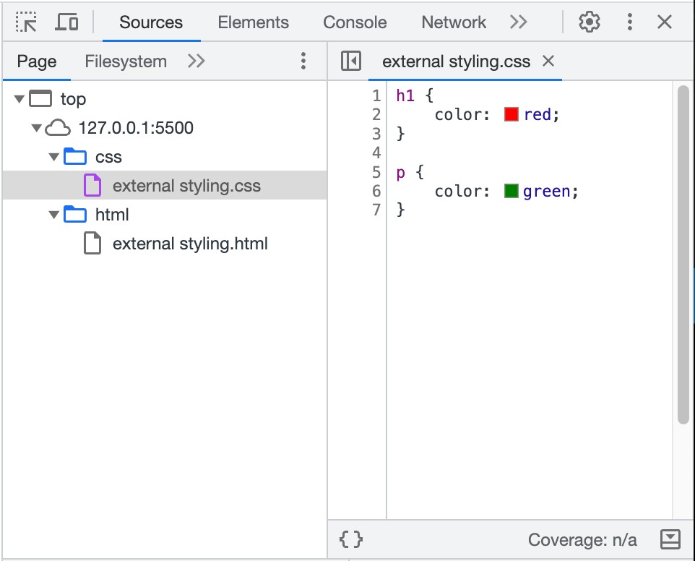
7.Browser Tools (Source tab)

Slide 26
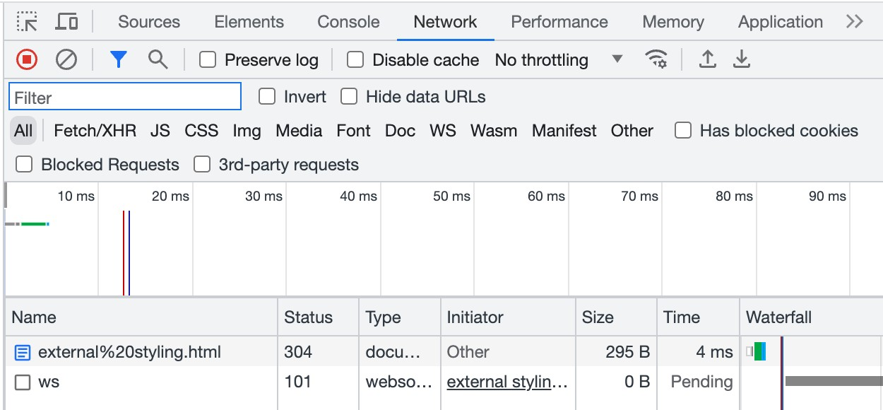
7.Browser Tools (Network tab)

Slide 27
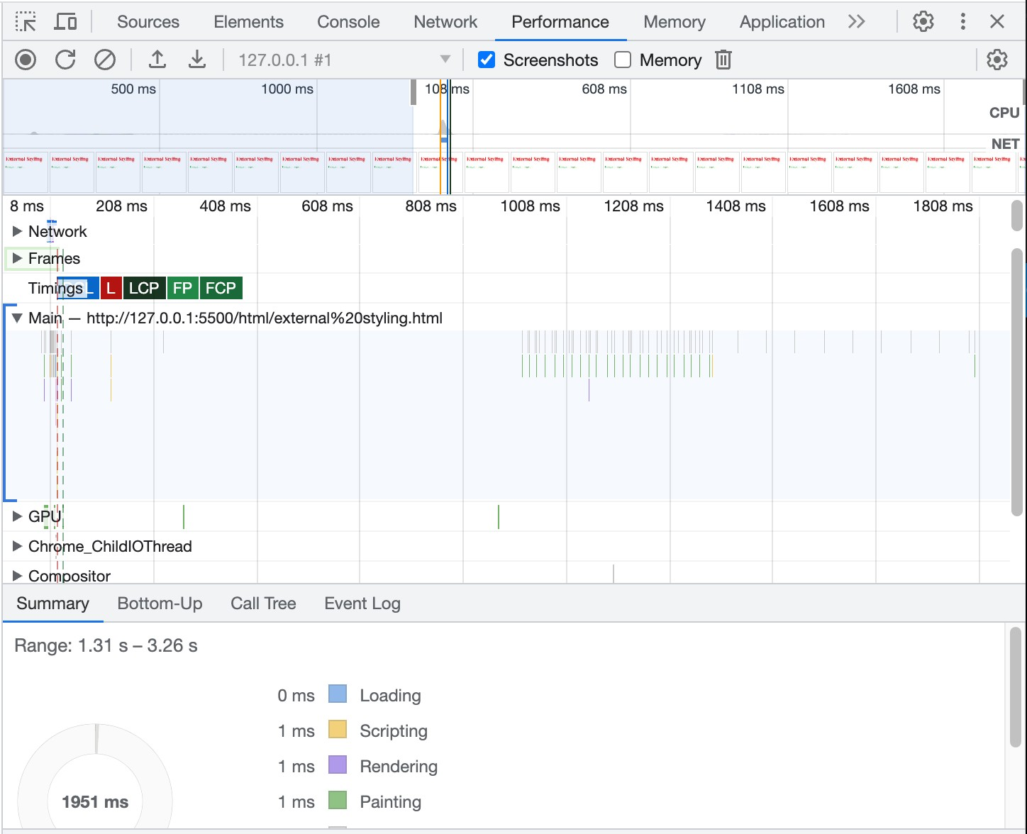
7.Browser Tools (Performance tab)

Slide 28
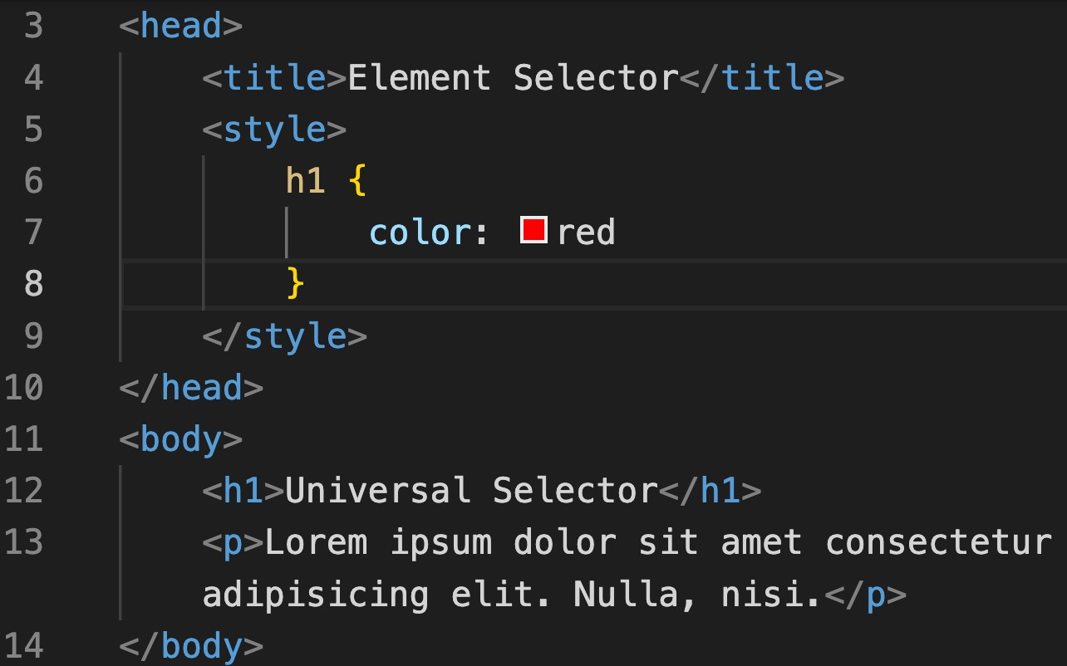
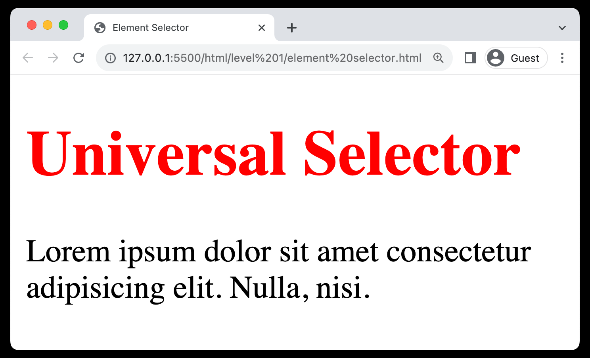
8. Selectors (Element selector)
Targets Elements: Selects HTML elements based on their tag name.
Syntax: Simply use the element's name
Uniform Styling: Helps in applying consistent styles to all instances.
Ease of Use: Straightforward and easy to implement for basic styling.

Slide 29
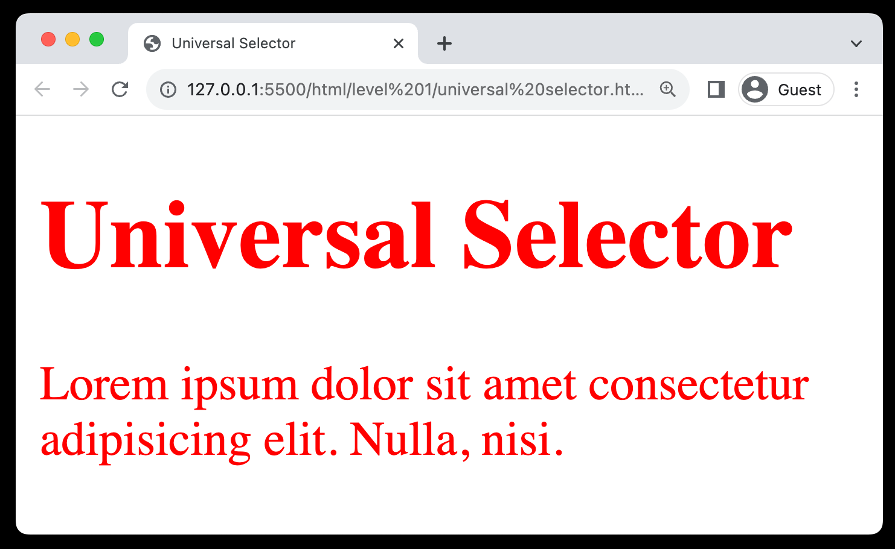
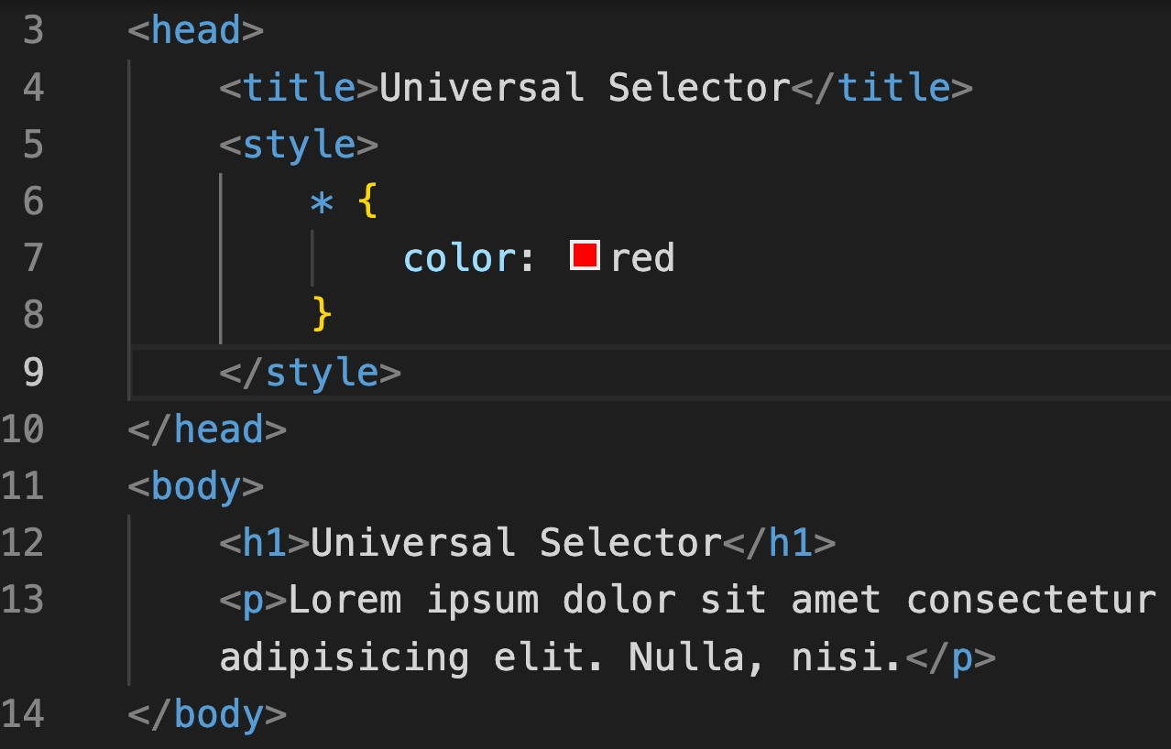
8. Selectors (Universal selector)
Matches All: Targets and styles all elements on a webpage.
Syntax: Utilized as an asterisk (*).
Resets Styles: Commonly used to reset margins and paddings globally.
Broad Styling: Useful for setting universal attributes like font or color.
Usage Caution: Can cause style conflicts due to its wide-reaching effects.

Slide 30
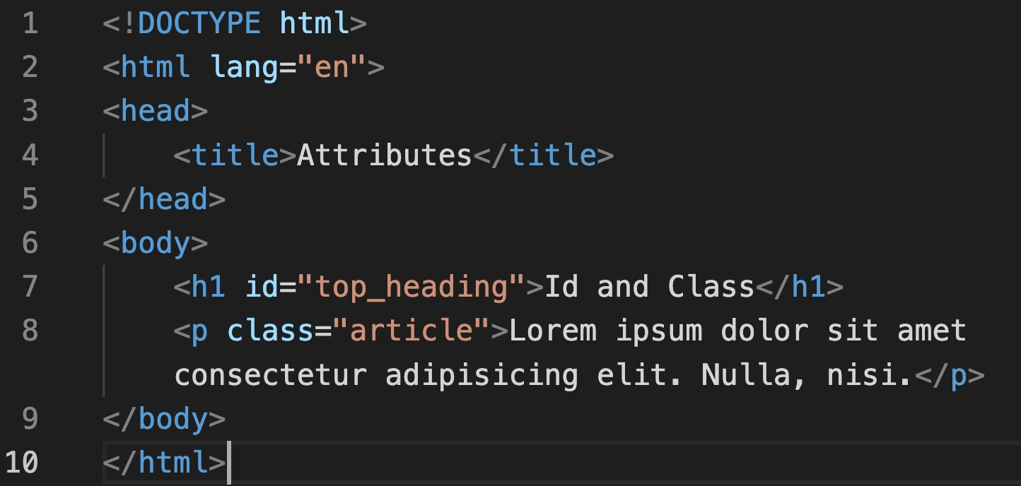
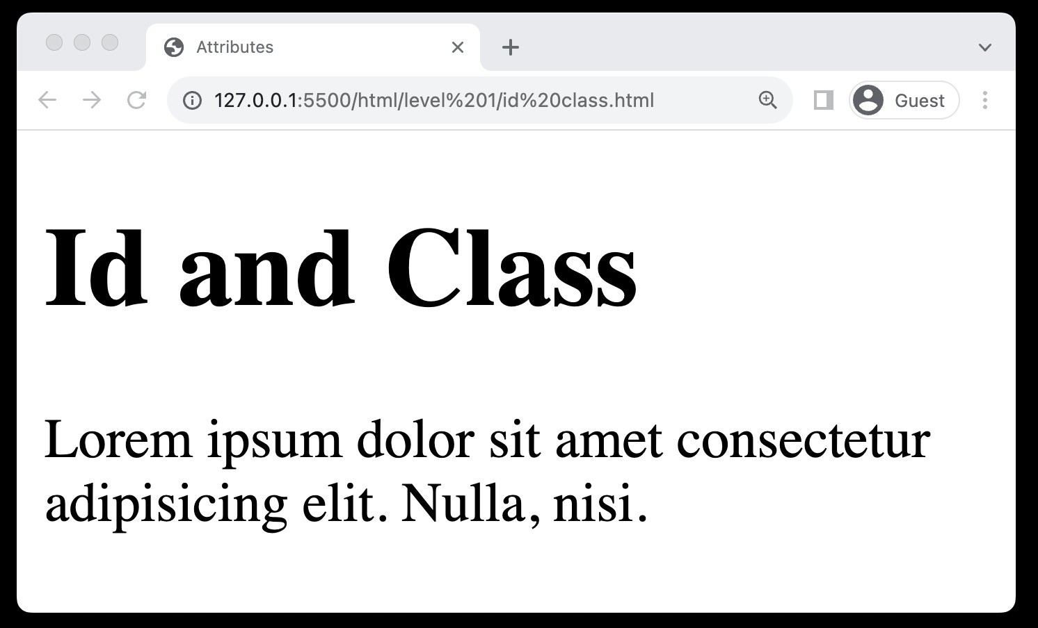
8. Selectors (id & class property)
ID Property: Assigns a unique identifier to a single HTML element.
Class Property: Allows grouping of multiple HTML elements to style them collectively.
Reusable Classes: Class properties can be reused across different elements for consistent styling.
Specificity and Targeting: Both properties assist in targeting
specific elements or groups of elements for precise styling.

Slide 31
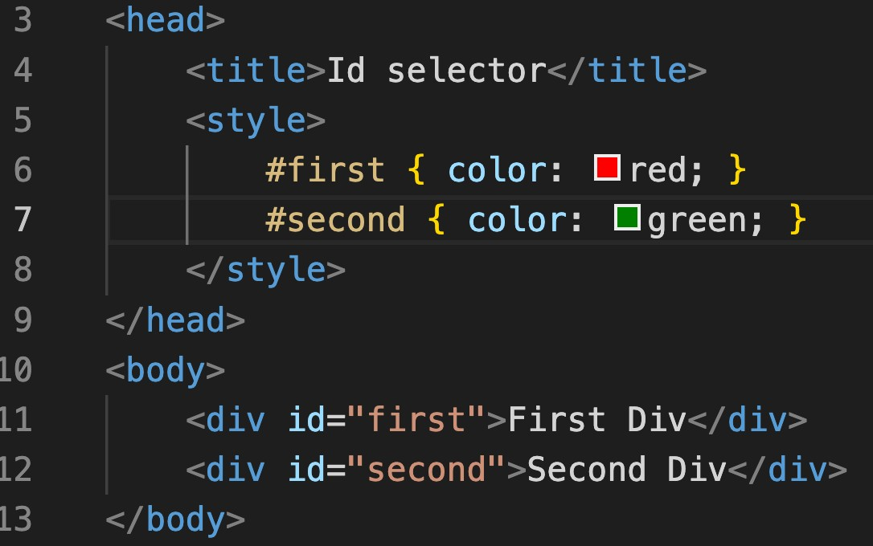
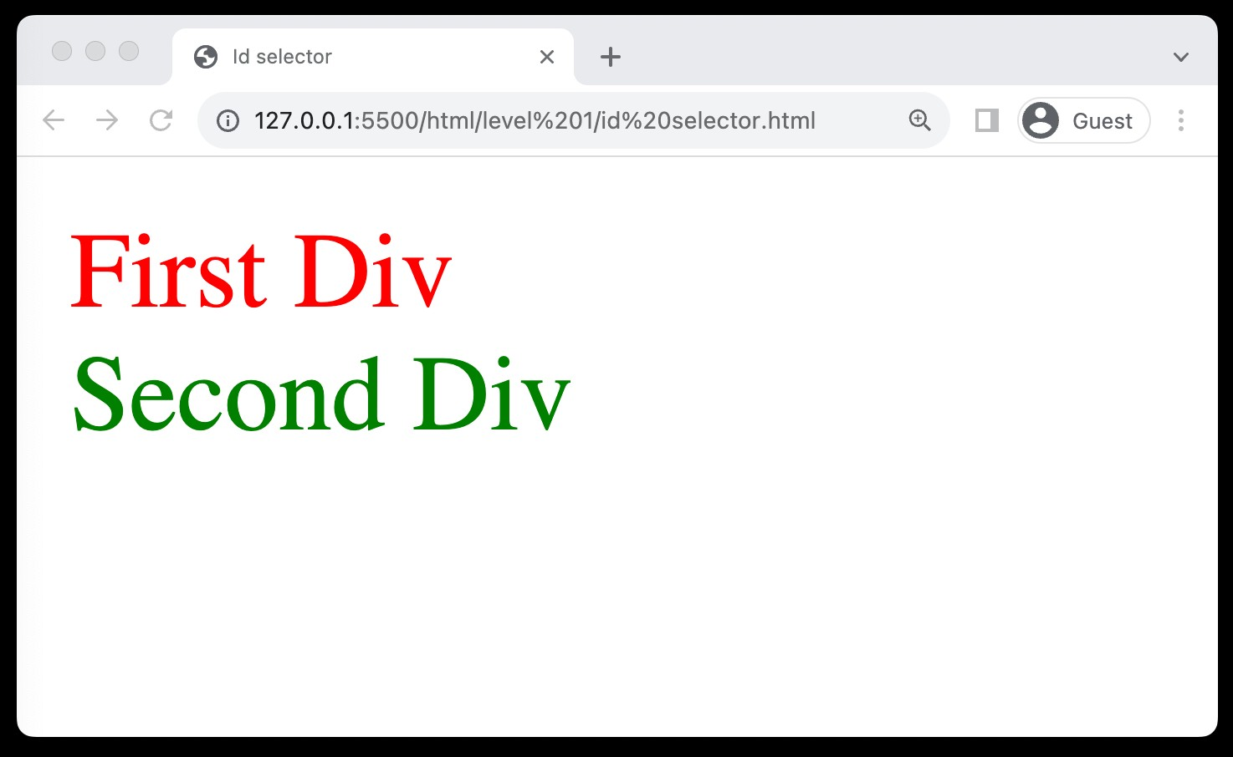
8. Selectors (Id selector)
Unique Identifier: Targets a specific element with a unique ID attribute.
Syntax: Uses the hash (#) symbol
Single Use: Each ID should be used once per page for uniqueness.
Specific Targeting: Ideal for styling individual, distinct elements.

Slide 32
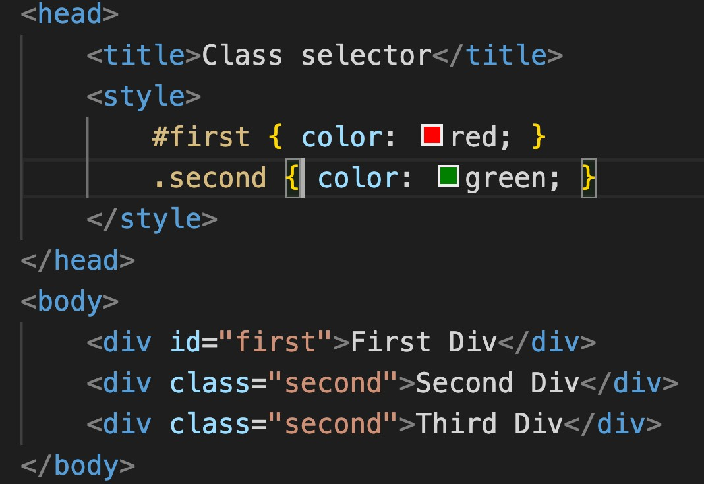
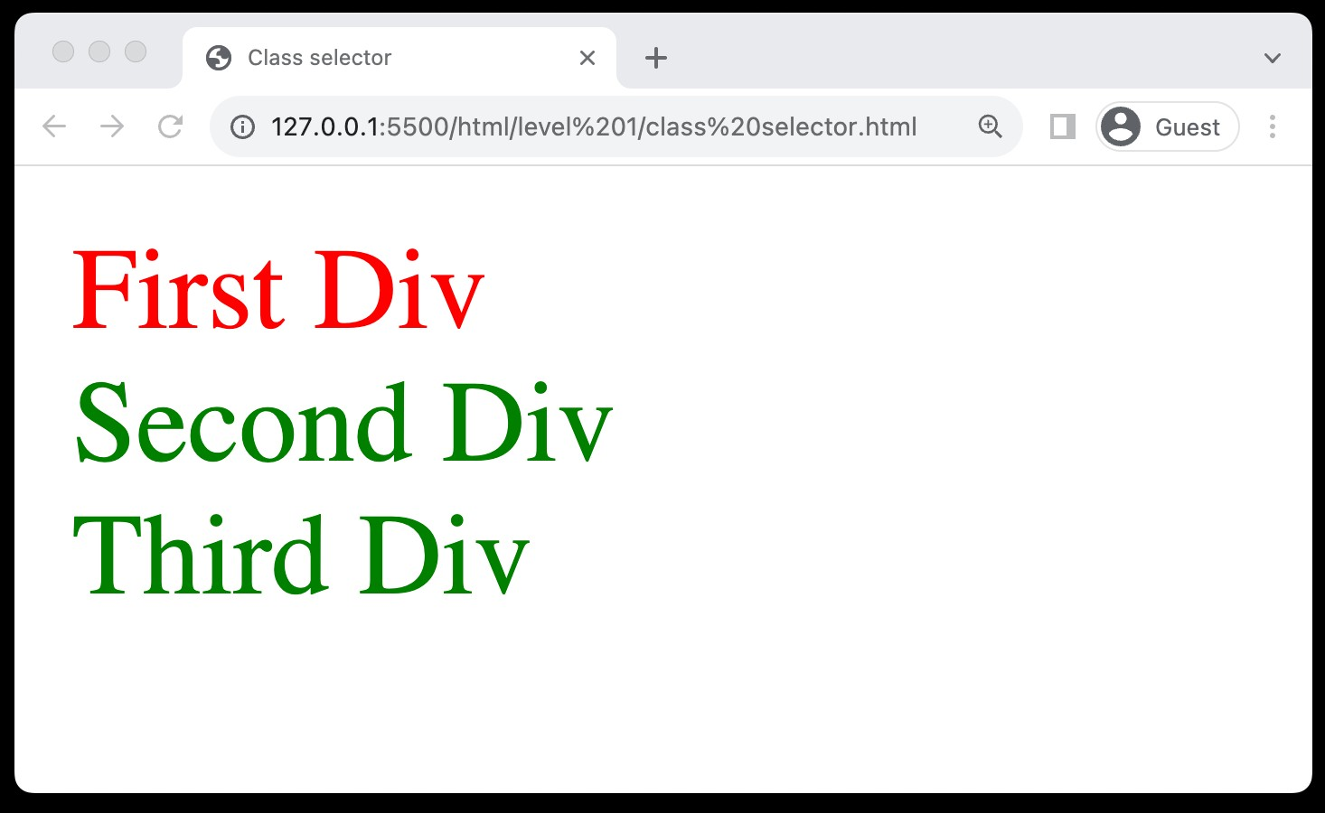
8. Selectors (Class selector)
Group Styling: Allows styling of multiple elements grouped under a class.
Syntax: Utilizes the dot (.) symbol.
Reusable: Can be used on multiple elements for consistent styling.
Versatility: Ideal for applying styles to a category of elements.

Slide 33
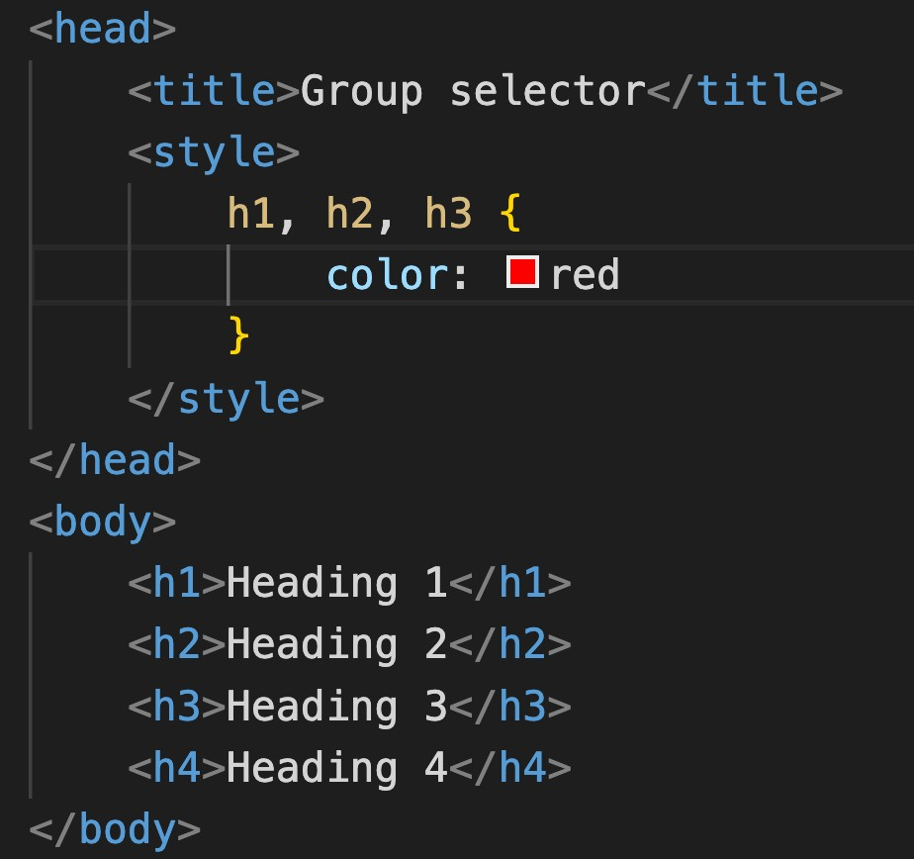
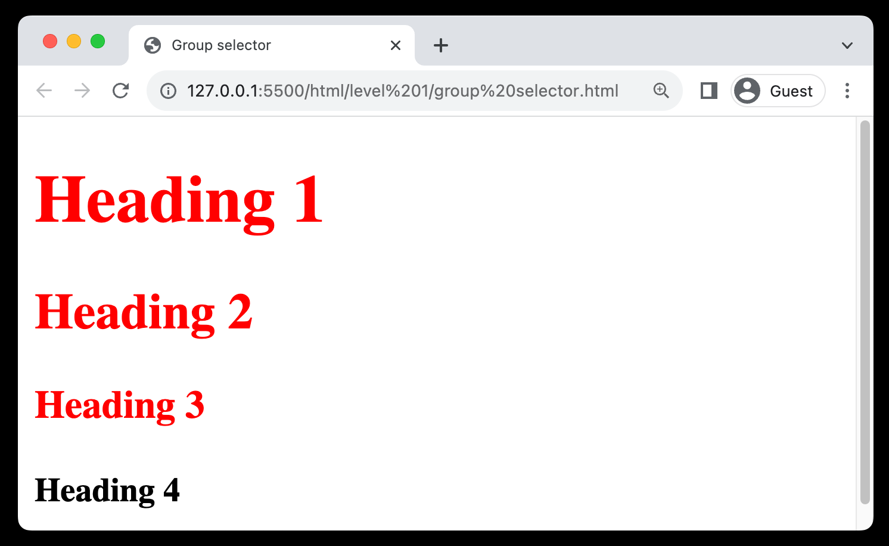
8. Selectors (Group selector)
Multiple Elements: Styles multiple elements simultaneously.
Syntax: Separates selectors with commas.
Efficiency: Reduces code redundancy and saves time.

Slide 34
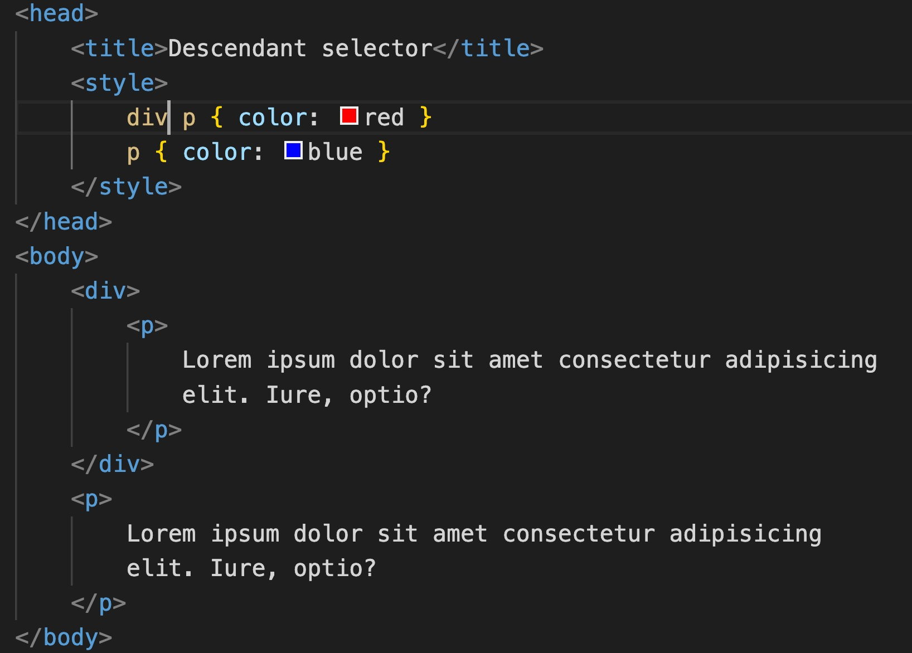
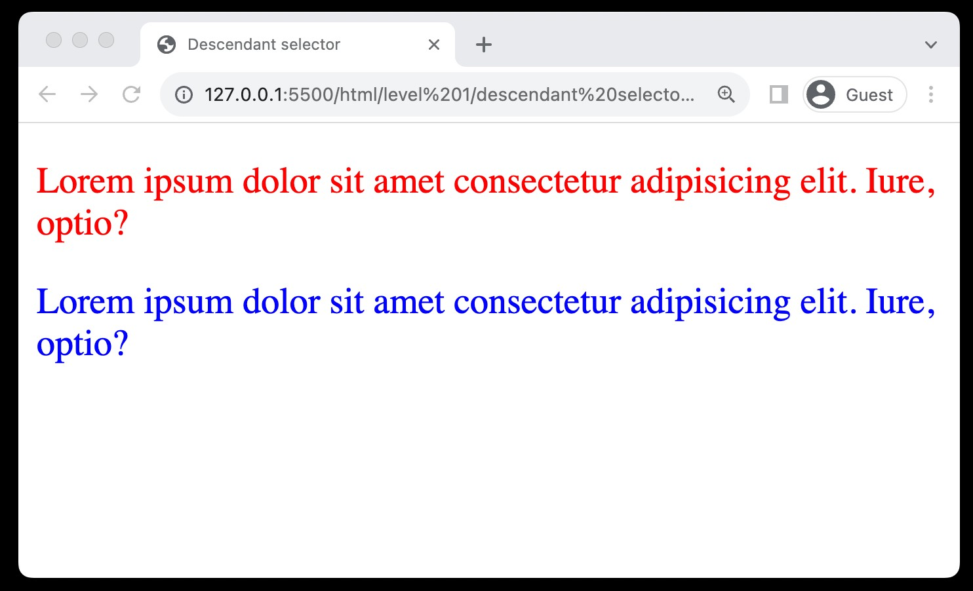
8. Selectors (Descendant selector)
Nested Targeting: Styles elements nested within a specified element.
Syntax: Separate selectors with spaces.
Hierarchy-Based: Allows styling based on the hierarchical structure of HTML.
Specific Styling: Facilitates more targeted and specific styling of elements.

Slide 35

Level 1 Revision
CSS Basics
Basic Syntax
Color Property
Including Styles
HTML Refresher
Comments
MDN Documentation
Browser Tools
Selectors

Slide 36

Practice Set Level 1
CSS Basics
Create a heading and set the text color red.
Create a div with id #heading, include CSS using all 3 ways line, style tag and external, and observe priority.
Add comments to your CSS class
Create a div, paragraph and heading and use id Selector, element selector and class selector for them.
Create two divs with id first and second and define color for both using group selector.

Slide 37
Level 2
Color System & Background
Background-Color Property
Color System
Absolute Units
Height & Width Property
Background-Image Property
Visibility Property

Slide 38
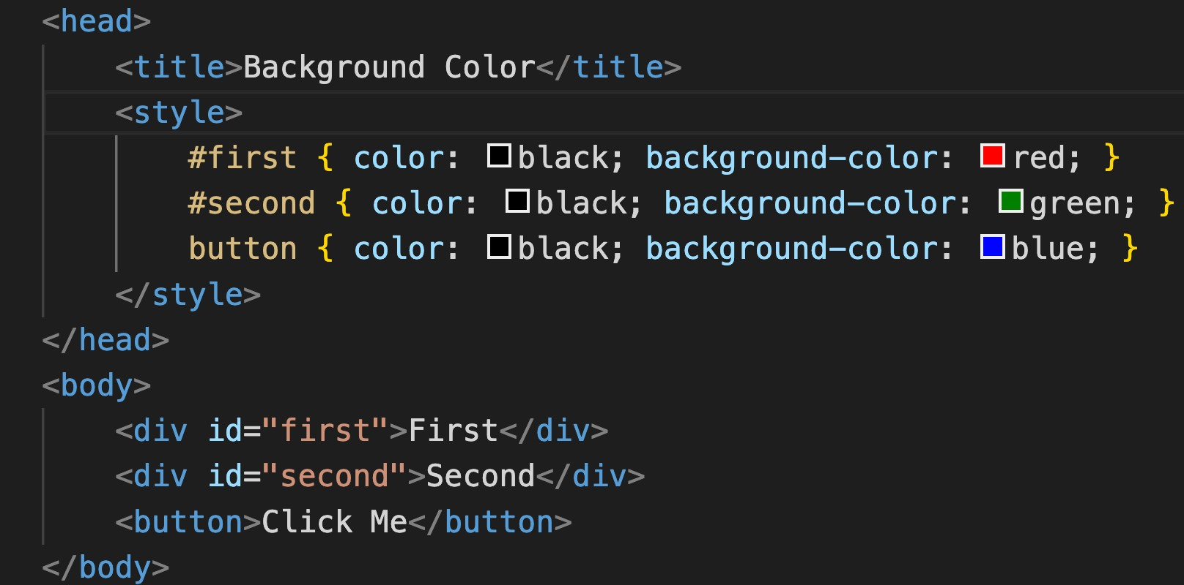
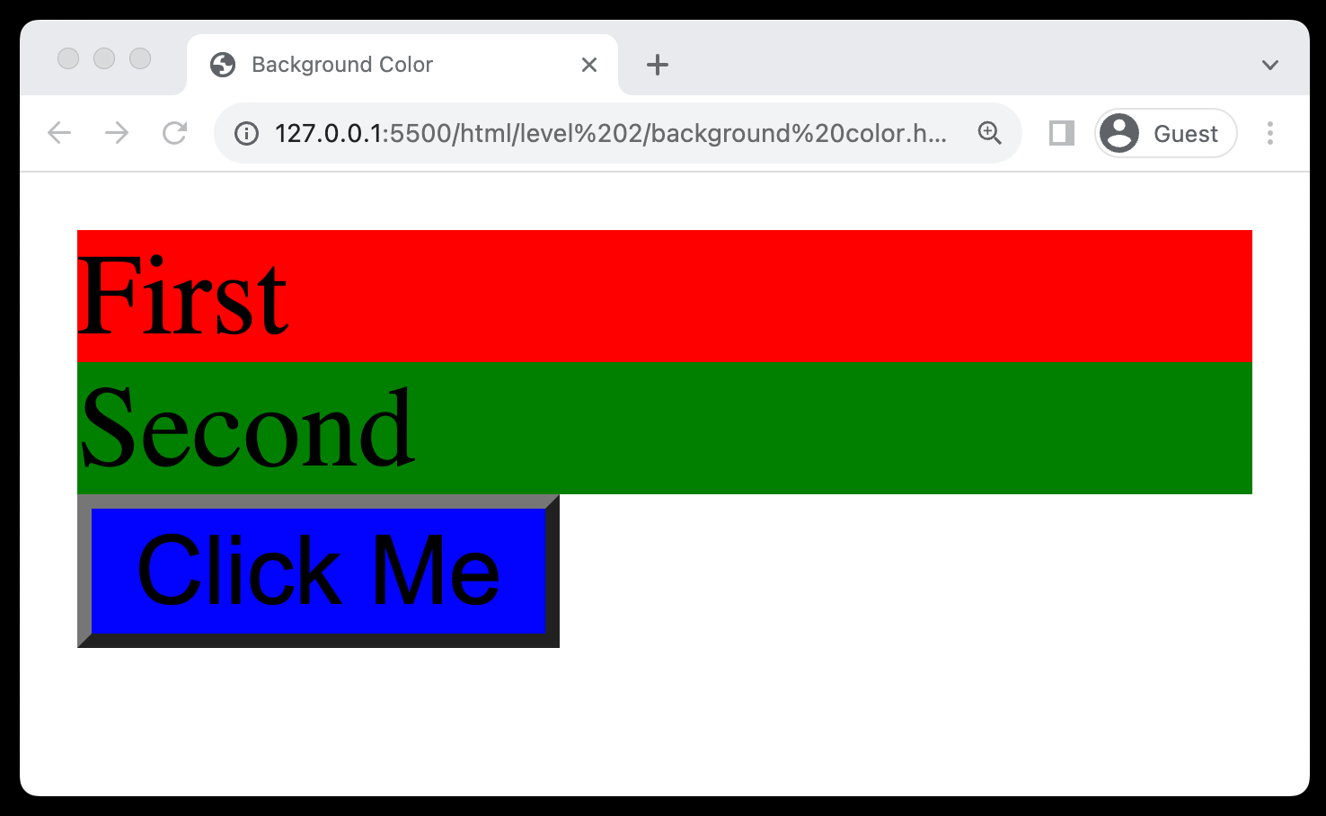
9. Background Color
Definition: Sets the background color of an element.
Syntax: Utilized as background-color: color;
Visual Appeal: Enhances the visual appeal and contrast of webpage elements.

Slide 39
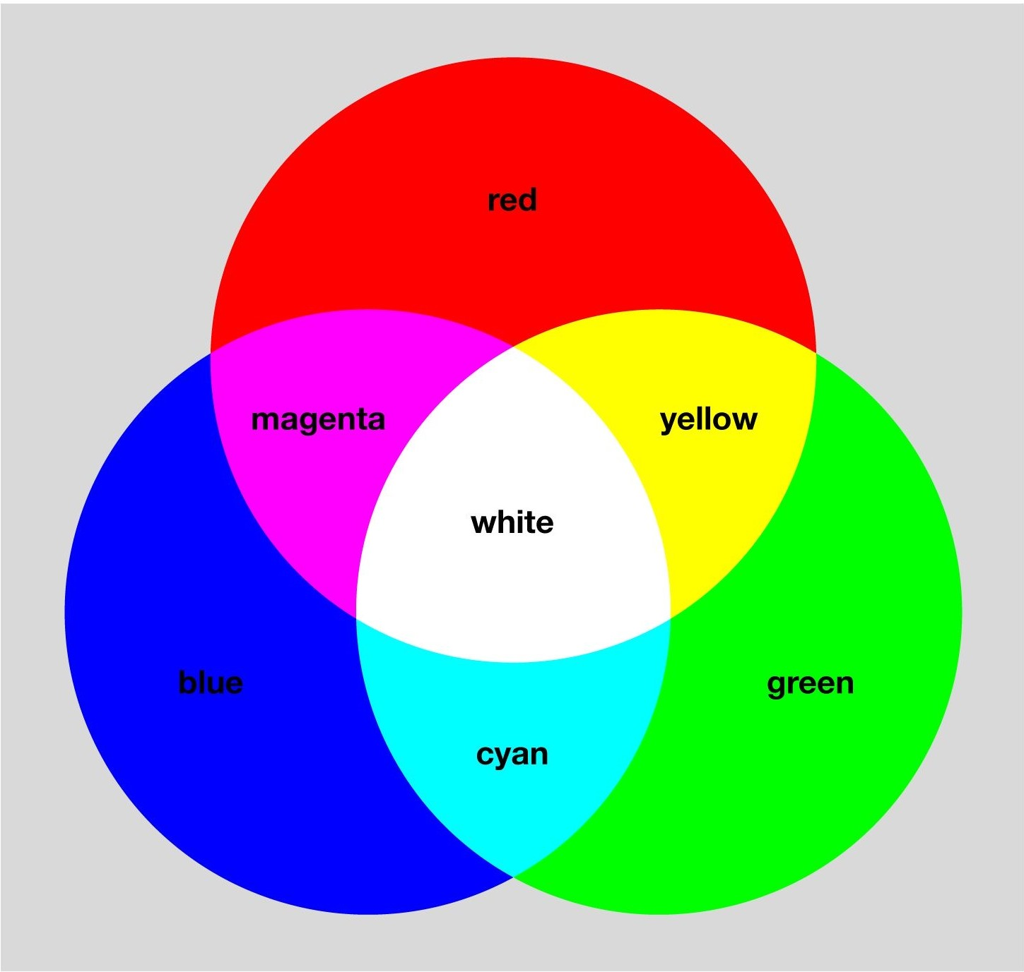
10. Color System (Color Theory)
RGB Model: Creates colors by mixing Red (R), Green (G), and Blue (B) light sources.
Additive Model: More light means increased brightness.
Primary Colors: R, G, and B are the foundational colors.
White & Black: All combined yield white; absence equals black.
Color Depth: Allows for millions of color variations.

Slide 40
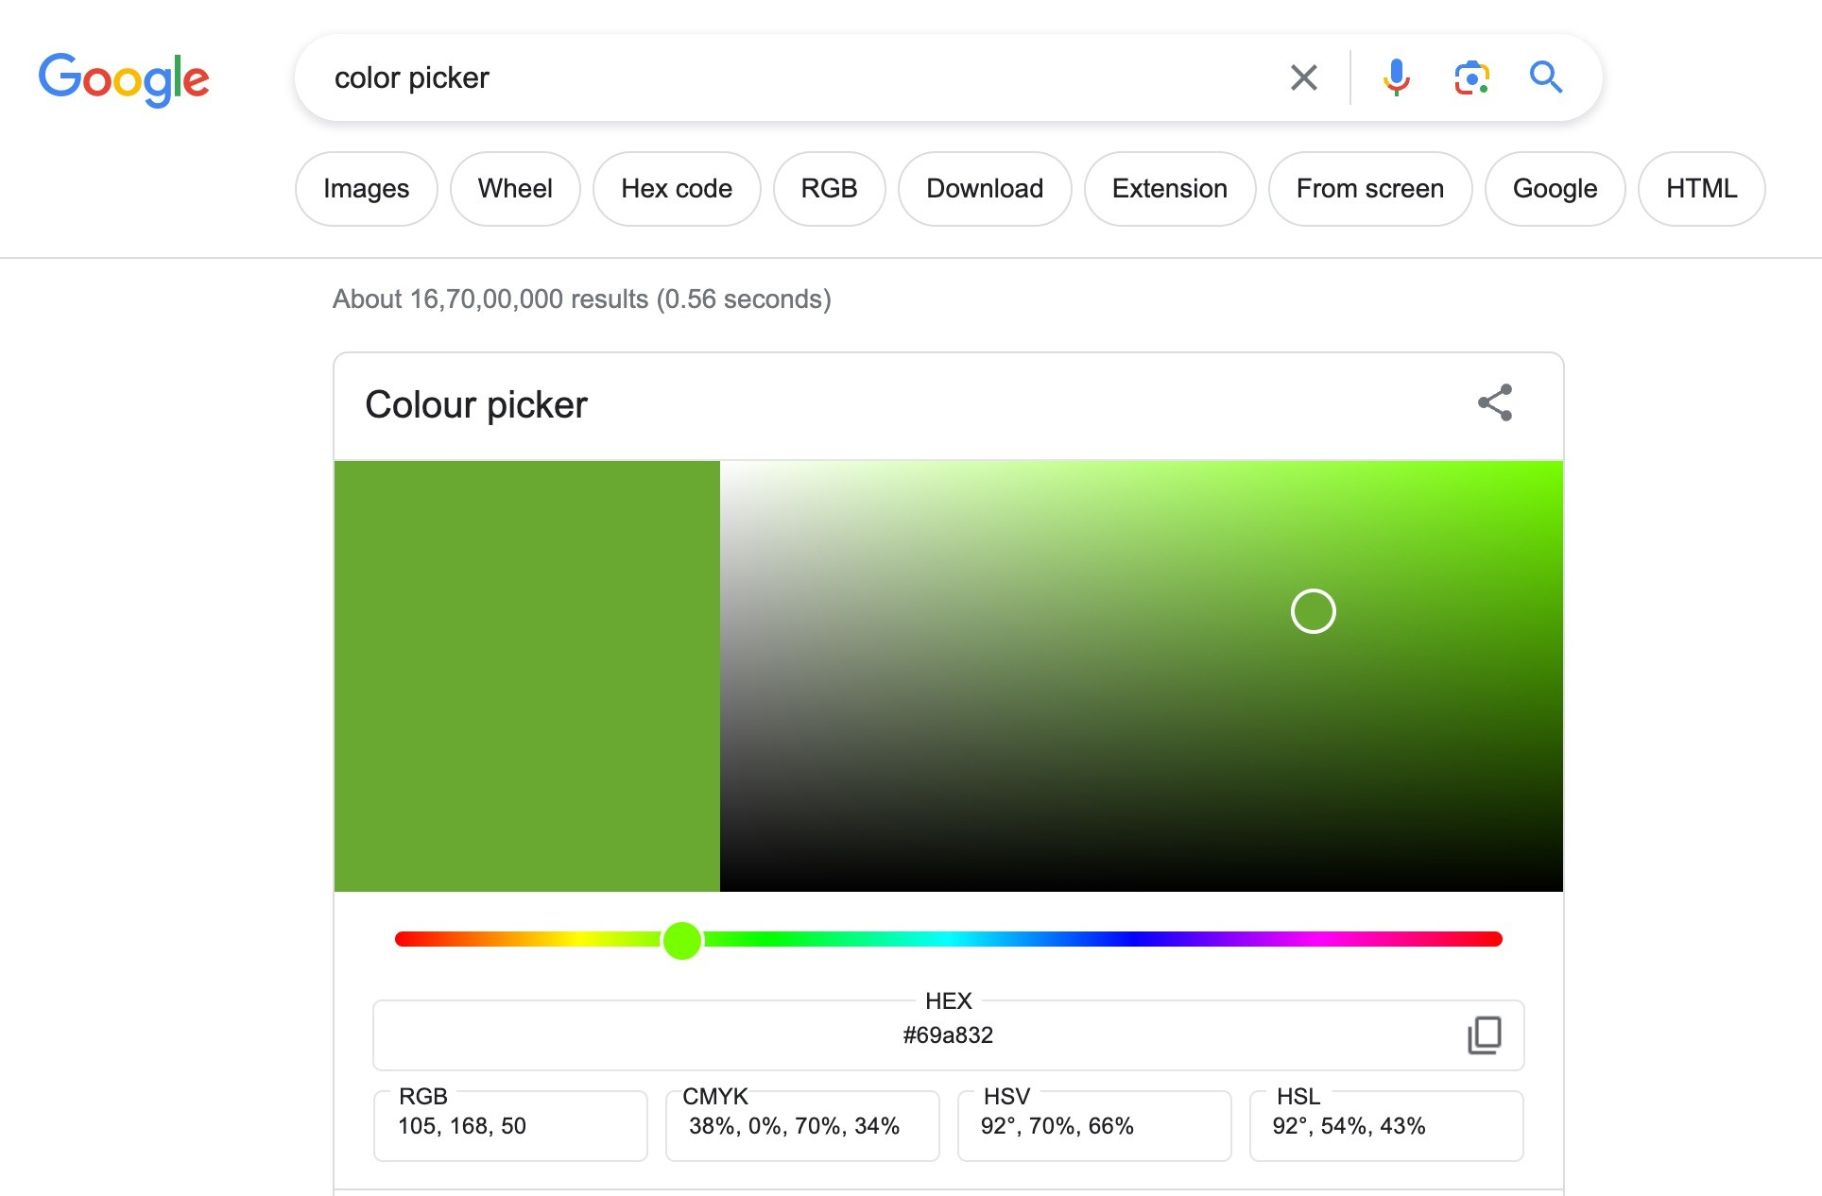
10. Color System (color picker)

Slide 41
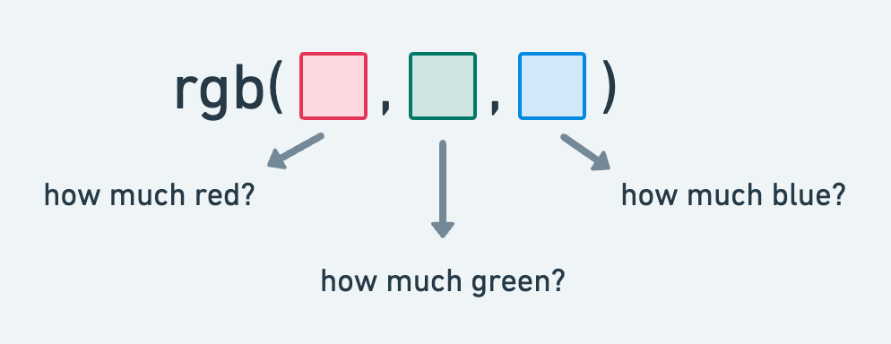
10. Color System (RGB Color Model)
Three Channels: Consists of Red (R), Green (G), and Blue (B) channels to create a variety of colors.
Syntax: Utilized as rgb(r, g, b) where r, g, and b are values between 0 and 255.

Slide 42
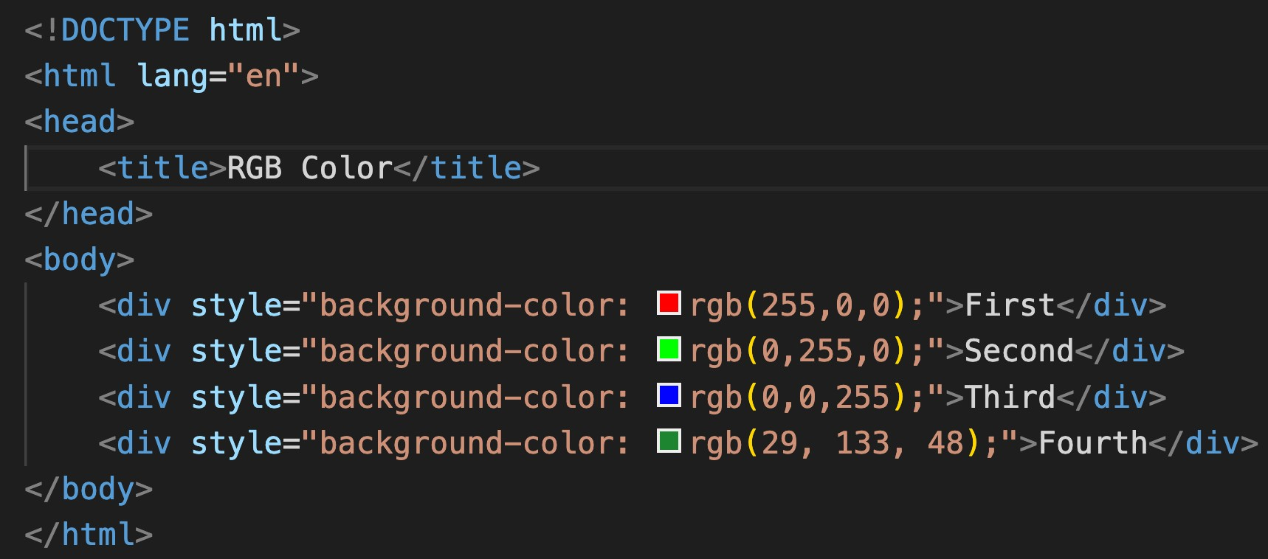
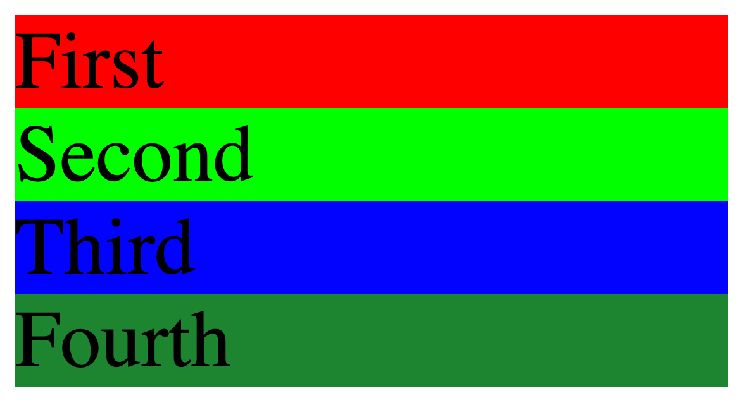
10. Color System (RGB Color Model)

Slide 43
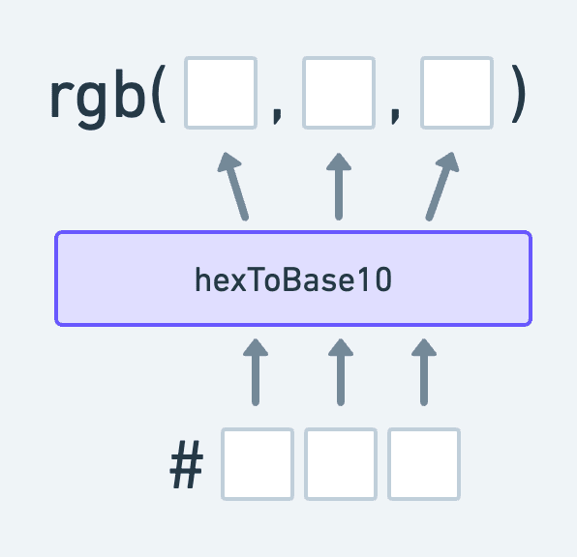
10. Color System (HEX Color Model)
Hexadecimal Codes: Represents colors using hexadecimal values, consisting of 6 digits combined from numbers and letters (A-F).
Syntax: Written as #RRGGBB
Easy Color Matching: Facilitates easy color matching with graphic design tools and branding colors.
Web Standards: Widely supported and a common standard for defining colors in web design

Slide 44
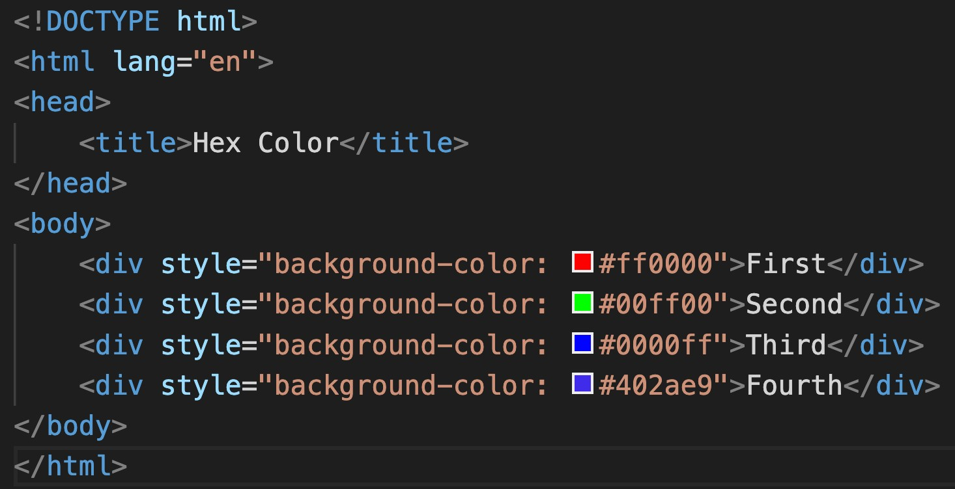
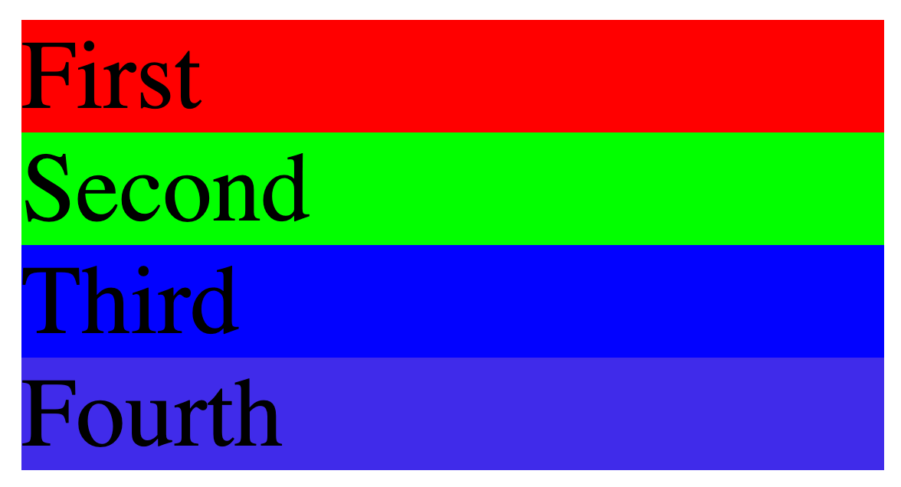
10. Color System (HEX Color Model)

Slide 45
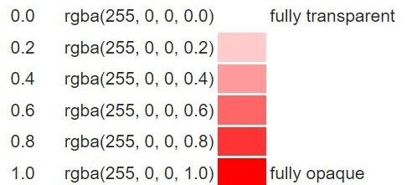
10. Color System (Alpha Channel)
RGBA: RGB's extension, includes alpha for opacity control (0-1 range).
Transparency Control: Facilitates the adjustment of transparency levels in colors.
Visual Effects: Enables the creation of visual effects like shadows and overlays.
Layering: Assists in layering elements with varying degrees of visibility.

Slide 46
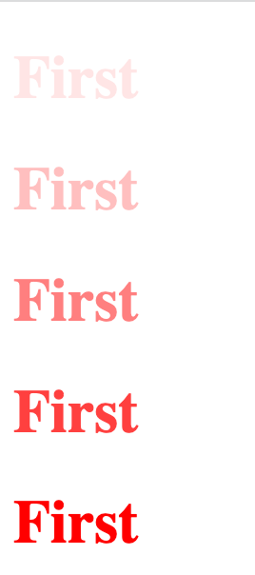

10. Color System (Alpha Channel)

Slide 47

11. Absolute Units
Definition: Pixels (px) are fixed-size units, representing a dot on a computer screen.
Precision: Allows for precise control over element dimensions.
Graphics & Web Design: Commonly used in graphics and web design for setting font sizes, margins, and more.
Cross-Browser Consistency: Provides consistency across different browsers.
High-DPI Displays: Can vary in appearance on high-DPI (dots per inch) displays.

Slide 48


12. Height & Width Property
Dimensions Control: Used to specify the height and width of elements.
Unit Variability: Can use units like pixels (px)
Box Model Component: Influences padding, border, and margin.
Min and Max Values: Can utilize min-height, max-height, min-width, and max-width to set restrictions on dimensions.

Slide 49


13. Background image Property
Usage: Adds an image as a background to elements.
Syntax: Defined using background-image: url('path/to/image’);.
Repetition: Control image repetition using
background-repeat.
Positioning: Adjust image position using background- position.
Size Control: Manipulate image size using background-size.
Background-Attachment: Sets whether the background image scrolls with the element or remains fixed.
Shorthand (color, image, repeat, attachment, position)

Slide 50


14. Visibility Property
Usage: Controls the visibility of elements without changing the layout.
Values: Can take visible, hidden, or collapse as values.
Space Occupancy: Even when hidden, the element occupies space.
Interactivity: Hidden elements are not accessible to user interactions.

Slide 51

Level 2 Revision
Color System & Background
Background-Color Property
Color System
Absolute Units
Height & Width Property
Background-Image Property
Visibility Property

Slide 52
Practice Set Level 2
Color System & Background
Create a div bar with text and background color with opacity
Change the color of the main
content
Add background image to one div
Use background shorthand property

Slide 53


15.Text-Align Property
Usage: Controls the horizontal alignment of text within an element.
Values: Can take values like left, right, center, and justify.
Visual Appeal: Enhances readability and visual appeal by organizing text neatly.

Slide 54


16. Text-Decoration Property
Usage: Modifies the appearance of inline text.
Values: Options include none, underline, overline, and line-through.
Hyperlinks: Commonly used to remove underlines from hyperlinks for
aesthetic purposes.

Slide 55


16. Text-Decoration Property (style)

Slide 56


16. Text-Decoration Property (color)

Slide 57


17. Text-Transform Property
Usage: Controls the capitalization of text.
Common Values: Can be uppercase, lowercase, or capitalize.
None Value: none value disables text transformations.
Typography: Useful for setting text style and improving typography in web design.

Slide 58


18. Line Height
Usage: Adjusts the amount of space above and below inline elements.
Readability: Enhances text readability by preventing overcrowding.
Vertical Spacing: Useful for controlling vertical spacing between lines
of text.

Slide 59


19. Font Property (font-size)
Usage: Sets the size of the font in web content.
Responsiveness: Helps in creating responsive designs adaptable to various screen sizes.
Readability: Crucial for ensuring the readability of text on websites.

Slide 60


19. Font Property (font-weight)
Usage: Defines the thickness of characters in a font.
Values: Can take values like normal, bold, bolder, or numeric values (100 to 900).
Text Emphasis: Utilized to emphasize text or create contrast between text elements.

Slide 61


19. Font Property (font-style)
Usage: Controls the style of the font, mainly affecting its inclination.
Values: Common values are normal, italic, and oblique.
Text Formatting: Useful for highlighting or distinguishing certain text segments.

Slide 62

20. Font Family
Usage: Defines which font should be used for text within an element.
Specific Fonts: Common choices include Arial, Segoe UI, Times New Roman, and others.
Fallback Mechanism: Incorporate a fallback
font family in case the primary font is unavailable; helps in maintaining the site aesthetics.
Web Safe Fonts: Employ web-safe fonts to ensure consistency across different browsers and operating systems.
Generic Family: Always end the font family list
with a generic family like serif or sans-serif as a last resort option.

Slide 63


20. Font Family

Slide 64


21. Icons using Fonts
Using https://fontawesome.com

Slide 65
Level 3 Revision
Text Properties
Text-Align Property
Text-Decoration Property
Text-Transform Property
Line-Height Property
Font Properties
Font Family
Icon using fonts

Slide 66
Practice Set Level 3
Text Properties
Create an Heading at the centre and make capitalized
Use Font family for the whole page to TimeNewRoman
Create one div inside another div. Set id and text outer to outer div,
set id and text inner to inner div. Set outer div text size to 25px.
Set inner to 10px.
Use icons from fontawesome.com and use icons of LinkedIn and GitHub

Slide 67
Level 4
Box Model
What is Box Model
Padding Property
Margin Property
Border Property

Slide 68

22. What is Box Model
fमठाई भ'डार पे चलो
Core Concept: Central concept in CSS that outlines the design and layout of elements on
the web page.
Components: Consists of four main components - margin, border, padding, and content.
Margin: The space outside the border,
separating the element from others.
Border: The outline that encapsulates the padding and content.
Padding: The space between the border and the actual content, providing a buffer.
Content: The innermost layer where text, images, or other media are housed.

Slide 69


23. Padding Property
Usage: Defines the space between the content of an element and its border.
Individual Sides: Allows setting padding for individual sides using
padding-top, padding-right, padding-bottom, and padding-left.
Shorthand: Can use shorthand property padding to set all sides at once, e.g., padding: 10px 20px 10px 20px.

Slide 70


24. Margin Property
Functionality: Sets the space around elements, separating them from others.
Individual Sides: Customizable for top, right, bottom, and left sides.
Shorthand: Allows quick setup, e.g., margin: 10px 20px. (clockwise)
Auto Value: Can be used for central alignment with auto value.

Slide 71



24. Border Property
Usage: Creates an outline around HTML elements.
Components: Defined by width, style, and color attributes.
Styles: Includes options like solid, dashed, and dotted.
Shorthand: Can set attributes at once, e.g., border: 2px solid black.

Slide 72


24. Border Property (border radius)
Usage: Used to create rounded corners for elements.
Individual Corners: Allows setting different radii for each corner.
Shorthand: e.g., border-radius: 10px 20px.

Slide 73




24. Border Property (box sizing)

Slide 74
Level 4 Revision
Box Model
What is Box Model
Padding Property
Margin Property
Border Property

Slide 75
Practice Set Level 4
Box Model
Create a div with height and width 200px and observe different values in the box model by inspecting.
Create a button and give 10px padding to top and bottom and 15px on the sides.
Add 100px margin to the button on all sides.
Add dotter border with color red and so much that the button becomes a circle.
Create two boxes with different box-sizing values and observe changes in box model.

Slide 76
Level 5
Display and Position
Display Property
Responsive Websites
Relative Units
Position Property
Semantic Tags

Slide 77


26. Display Property (Block / Inline Elements)
Block Elements
Inline Elements
New Line: Start on a new line.
Full Width: Take up all horizontal space.
Styling: Can have margins and padding.
Size: Width and height can be set.
Examples: <div>, <p>, <h1>, <ul>, <li>.
Flow: Stay in line with text.
Width: Just as wide as the content.
No Break: No new line between elements.
Limited Styling: Can't set size easily.
Examples: <span>, <a>, <strong>, <em>.

Slide 78



26. Display Property (Block)

Slide 79



26. Display Property (Inline)

Slide 80



26. Display Property (Inline-Block)

Slide 81



26. Display Property (None)

Slide 82

27. Responsive Website

Slide 83

27. Responsive Website
Adapts layout for different screen sizes
Flexible layouts
Optimizes images and assets
Enhances user experience on mobile and desktop

Slide 84

28. Relative Units

Slide 85



28. Relative Units (Percentage)
Relative Sizing: Facilitates dynamic sizing relative to parents.
Adaptability: Ensures responsiveness across various screens.
Dimensions: Quickly set width and height as a percentage.

Slide 86



28. Relative Units (EM)
Relative Unit: Sized relative to the parent element's font size.
Scalability: Facilitates easy scaling of elements for responsive design.
Font Sizing: Commonly used for setting font sizes adaptively.

Slide 87


28. Relative Units (REM)
Relative Sizing: Facilitates dynamic sizing relative to root element.
Adaptability: Ensures responsiveness across various screens.
Dimensions: Quickly set width and height as a percentage.

Slide 88


28. Relative Units (VW/VH)
Viewport Relative Units: Units based on viewport's width (vw) or height (vh) for responsive design.
Responsive Layouts: Essential for creating adaptive layouts; e.g., height: 100vh for full-screen sections.
Element Sizing: Useful for defining heights and widths that scale with the
viewport.

Slide 89

29. Position Property
Static (default) : Elements follow the normal document flow. (top, right, bottom, left, z-index would not work)
Relative: Element's position adjusted from its normal position.
Absolute: Positions element relative to the nearest positioned ancestor.
Fixed: Element positioned relative to the viewport, does not move on scroll.

Slide 90



29. Position Property

Slide 91



29. Position Property (z index)
Stacking Order: Determines the stacking order of elements along the Z-axis.
Position Context: Only applies to elements with position set to
relative, absolute, fixed, or sticky.
Integer Values: Accepts integer values, including negative numbers.
Higher Values: An element with a higher z-index value appears above others.

Slide 92


30. Semantic Tags

Slide 93
30. Semantic Tags
Semantic Tags
Non-Semantic Tags
Meaningful: Describe content.
SEO: Good for search engines.
Accessibility: Useful for screen readers.
Examples: <header>, <footer>,
<article>, <section>, <nav>.
Generic: No specific meaning.
For Styling: Used for layout.
No SEO: Not SEO-friendly.
Examples: <div>, <span>, <i>,
<b>.

Slide 94
Level 5 Revision
Display and Position
Display Property
Responsive Websites
Relative Units
Position Property
Semantic Tags

Slide 95
Practice Set Level 5
Display and Position
Create a webpage with header, footer, and a content area.
Header
Create a nav bar with links.
Main
Create a div with width and height, Background green and border radius 50%
Create Three divs with container height and width 100px. Display inline block.
Set the correct position property for the single div element to ensure it remains at the right side of the page and does not shift when
scrolling.
Use z-index to place the div on top of another div.
Footer
Add text in footer.

Slide 96
Level 6
Flex Box, Grid and Media Queries
Float Property
What is Flexbox?
Flex Model
Flexbox Direction
Properties: Flexbox container
Properties: Flex Items
Grid Layout
Media Queries

Slide 97



31. Float Property
Element Alignment: Allows elements to be aligned to the left or right within their containing element.
Values: Can take values like "left", "right", or "none" to determine the
floating direction.
Old Layout Technique: Less commonly used with the advent of Flexbox.

Slide 98

32. What is Flexbox?
Flexbox is a one-dimensional layout method for arranging items in rows or columns. Items flex (expand) to fill additional space or shrink to fit into smaller spaces.

Slide 99

33. Flex Model
display: flex

Slide 100

34. Flexbox Direction
Property Name: flex-direction is the property used to define the direction in a flex container.
Row Layout: row value aligns the flex items horizontally, in a left-to-right fashion.
Column Layout: column value stacks the flex items vertically, from top to bottom.
Reverse Direction: Adding -reverse to row or column (as in row-reverse or column-reverse) reverses the order of the items.

Slide 101



34. Flexbox Direction

Slide 102


34. Flexbox Direction

Slide 103

35. Properties: Flexbox container (Justify Content)
Alignment: Aligns flex items along the main axis.
flex-start: Items align to the start of the flex
container.
flex-end: Items align to the end of the flex container.
Center: Items are cantered within the flex container.
space-between/space-around/space-evenly: Distributes space between items evenly.

Slide 104


35. Properties: Flexbox container (Justify Content)

Slide 105

35. Properties: Flexbox container (Flex Wrap)

Slide 106


35. Properties: Flexbox container (Flex Wrap)

Slide 107


35. Properties: Flexbox container (Align Items)
This property is used to align the flex container's items along the cross-axis, which is perpendicular to the main axis.

Slide 108


35. Properties: Flexbox container (Align Content)
It is utilized to adjust the spacing between flex lines within a flex container, particularly when there is extra space along the cross- axis.

Slide 109


36. Properties: Flex Items (Align Self)
Allows individual flex items to override the container's align-items property, aligning them differently along the cross-axis.

Slide 110


36. Properties: Flex Items (Flex Shrink)
The "flex-shrink" property in CSS determines how much a flex item will shrink relative to other items in the flex container if there is insufficient space.

Slide 111


36. Properties: Flex Items (Flex Grow)
The "flex-grow" property in CSS specifies how much a flex item will grow relative to other items in the flex container when additional space is available.

Slide 112


36. Properties: Flex Items (Order)
The "order" property in CSS allows you to define the sequence in which flex items appear within the flex container, overriding their original order in the HTML.

Slide 113

37. Grid

Slide 114



37. Grid
2D layout system for rows & columns.
Activate with display: grid;.
Children become grid items.
Define structure with grid-template properties.
Individual units called grid cells.

Slide 115

38. Media Queries
Tailor styles for specific device characteristics.
Use to create responsive web designs.
Apply styles based on conditions like screen size.
Syntax: @media (condition) { CSS rules
}.
Can combine multiple conditions using and, or.

Slide 116


38. Media Queries (width)

Slide 117


38. Media Queries (min-width)

Slide 118


38. Media Queries (max-width)

Slide 119


38. Media Queries (combination)

Slide 120
Level 6 Revision
Flex Box, Grid and Media Queries
Float Property
What is Flexbox?
Flex Model
Flexbox Direction
Properties: Flexbox container
Properties: Flex Items
Grid Layout
Media Queries

Slide 121
Practice Set Level 6
Flex Box, Grid and Media Queries
Create the same nav bar created in the last Practice Set but do the spacing using flexbox.
Use flexbox to centre an image inside a div.
Create a div with three boxes where two
boxes have fixed size, but the third box grows and shrinks with container size.
Create a div of 50px by 50px with color
green. It should respond to following conditions:
Keep color green under 300px of view port size
Change color to red from 300px to 400px
Change color to blue after 400px

Slide 122
Level 7
Animation, Transition & Transform
Pseudo Classes
Transitions
CSS Transform
Animation

Slide 123


39. Pseudo Classes
Used to define special states of HTML elements.
Syntax: selector:pseudo-class { styles }.
Common examples: :hover, :active, :first-child.
Target elements based on their position or user action.

Slide 124

40. Transitions
CSS transition is a property that enables smooth animation between changes in CSS property values
transition-property: Defines which CSS properties will transition.
transition-duration: Sets how long the transition lasts.
transition-timing-function: Controls the speed curve of the transition.
transition-delay: Specifies a delay before the transition starts.

Slide 125


40. Transitions

Slide 126

41. CSS Transform
Allows modification of an element's shape and position.
Can perform operations like rotate, scale,
and translate.
Does not affect the layout of surrounding elements.
Used to create visual effects like 3D space
transformations.
Implemented with functions like rotate(), scale(), and translate().

Slide 127


41. CSS Transform (Rotate)
Rotates an element around a fixed point.
Defined using the rotate() function within the transform property.
Default rotation point is the element's center.

Slide 128


41. CSS Transform (Scale)

Slide 129


41. CSS Transform (Translate)

Slide 130


41. CSS Transform (Skew)

Slide 131

42. Animation

Slide 132
42. Animation Properties
animation-name: Specifies the name of the @keyframes defined animation.
animation-duration: Defines the total time the animation takes to complete one cycle.
animation-timing-function: Controls the pacing of the animation (e.g., linear, ease-in).
animation-delay: Sets a delay before the animation starts, allowing for a pause before initiation.
animation-iteration-count: Indicates the number of times the animation should repeat.
animation-direction: Specifies the direction of the animation, allowing for reverse or alternate cycles.

Slide 133


42. Animation

Slide 134


42. Animation

Slide 135
Level 7 Revision
Animation, Transition & Transform
Pseudo Classes
Transitions
CSS Transform
Animation

Slide 136
Practice Set Level 7 Revision
Animation, Transition & Transform
- Create a webpage with a progress bar that showcases a smooth loading animation. The progress bar should fill up from 0 to 100% with a smooth transition effect and a slight bounce when it reaches 100%.

Slide 137
Project Myntra Clone

